Slide 1

FFL and the Common Core
Meredith Levine
Director of Family Engagement
Email: mlevine@fflib.org
Twitter: @schmoopie517
Margaret Portier
Director of Innovative
Family Services
Email: mportier@fflib.org
Twitter: @tophile
Common Core Learning Day 2013
Notes:
Meredith: Hello and thank you for coming to the FFL Common Core Learning Day. Today we are going to be sharing with you some of the things we have been doing here at the FFL to support the Common Core.

Slide 2
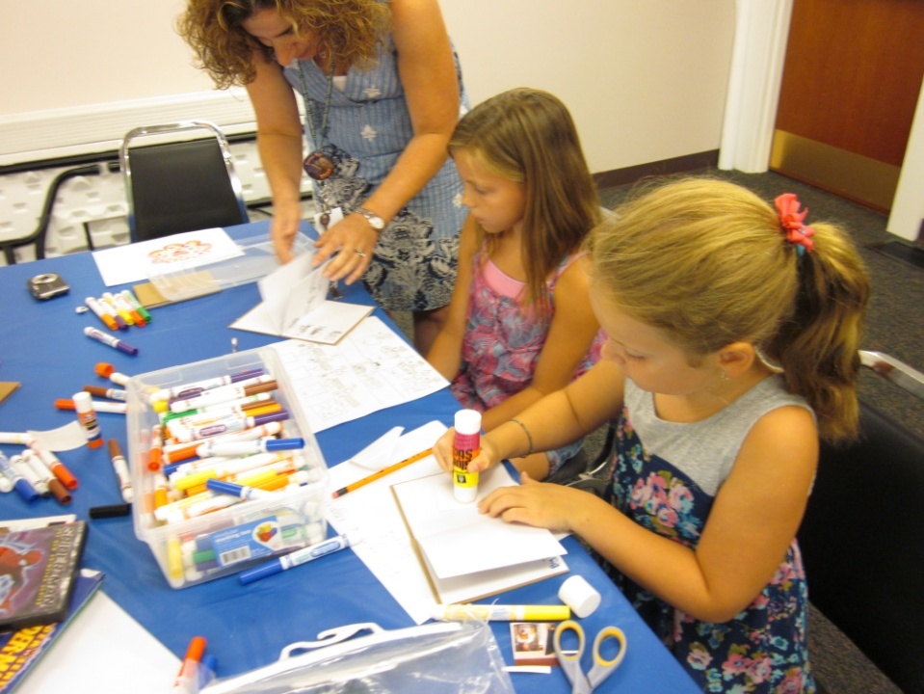
We all serve youth.
Notes:
First things first, we all serve youth, no matter what your position is in or outside of the library.

Slide 3
Patron Services
Being an information hub.

Slide 4
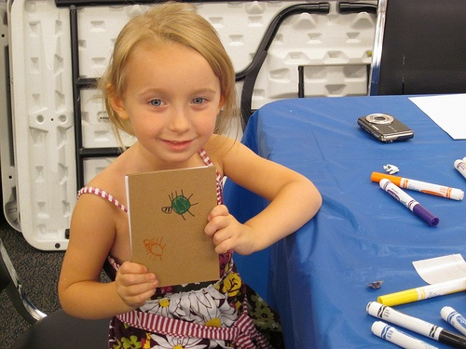
Patron Services
Develop a pamphlet or handout with resources for parents.
Gold Star indicators on the children's collections denoting Common Core Aligned.
Our library website will have a Common Core section with resources for parents and teachers.
Notes:
As the Common Core becomes more prevalent and an everyday word used by parents it is our job here at the FFL to provide access to the best resources for our patrons. We plan to develop a pamphlet with resources for parents on different ways to support their children with the Common Core, including programs, websites etc. As we switch into Dewey Hybrid here at the FFL (which we will talk about in a future slide) we want to create access to Common Core aligned material as easy as possible. We plan to use gold star stickers on books in our collection denoting that it is Common Core aligned. These mostly include our picture book collection and we will use signs in the library for patrons to know that the gold star means the book aligns with the standards. To make it easier for patrons to access more information about the Common Core we plan to have a Common Core section with resources for parents and teachers on our website, making the public library your one stop shop for information on the Common Core.

Slide 5
Collections
Supporting Common Core

Slide 6
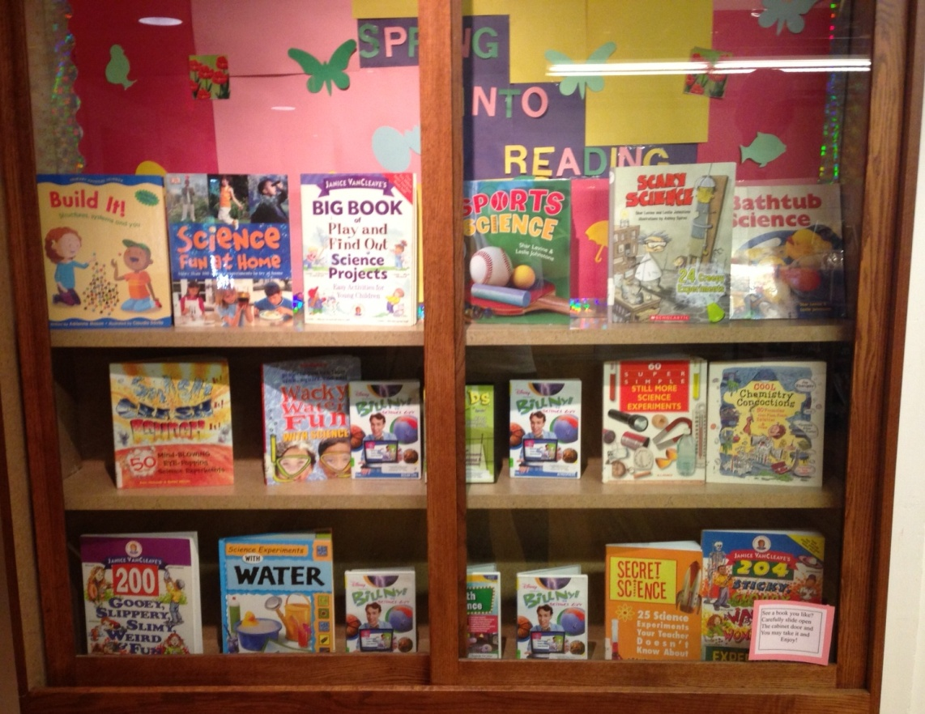
Collections - Nonfiction
Reallocated budget for nonfiction titles
Nonfiction materials integrated into displays
Shifting to Dewey Hybrid all around the library
  Integrating all media
Adding new material in the content areas to support STEM learning
Increasing nonfiction graphic novel offerings
Notes:
Meredith: This year, in an effort to support common core through our Children's non fiction budget we reallocated existing funds. Nonfiction materials have been more integrated into displays and in our new books shelf location. This has increased circulation and interest in the collection. We look at the library collection as a whole; we are working currently to shift to Dewey Hybrid which will encourage discovery and make browsing the nonfiction collection much easier as books are shelved by category. Media will be integrated onto the shelves as well, putting DVD”s about earthquakes for example next to books on earthquakes. New material in the content areas has been added to support STEM learning, carefully selecting items that are of interest in the field of science, technology, engineering and math. We have also increased the amount of nonfiction graphic novels.

Slide 7
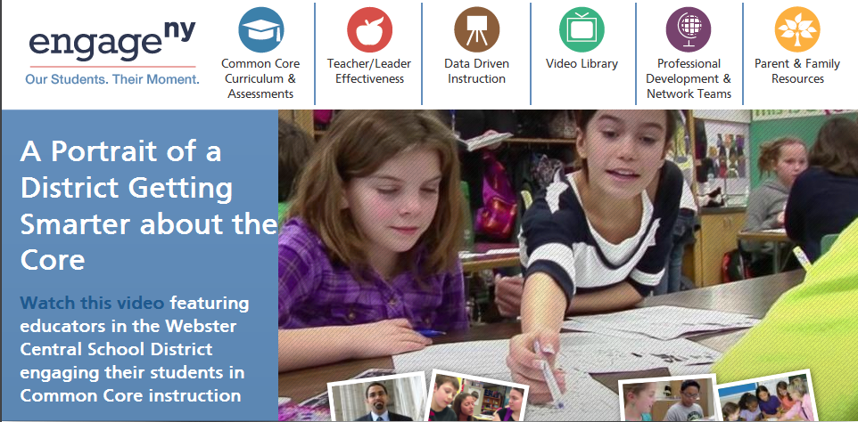
Collections - Nonfiction
Resources for finding books that support Common Core
      Appendix B
      School Library Journal
      EngageNY
      Corestandards.org Publishers Criteria
      Catalogs
Notes:
We have used a few resources to find books that support the Common Core including the Appendix B that is attached to the standards, School Library Journal is a great resource for new and exciting nonfiction that aligns with Common Core Standards. EngageNY has a plethora of information used to educate librarians and parents. This helps when choosing materials and the kinds of skills that should be used when reading these texts, for example by grade 2 students should be able to retell a story and determine the central message, this helps when choosing materials that can make this happen. Corestandards.org is another great source and we have distributed the publishers criteria section to other librarians at the FFL to help them understand what text according to publishers falls under alignment with the standards. We feel that all librarians should know where to access this information because we serve families not just students. Catalogs now have information on whether or not materials align with the standards and some even specify what particular standards the book aligns too.

Slide 8
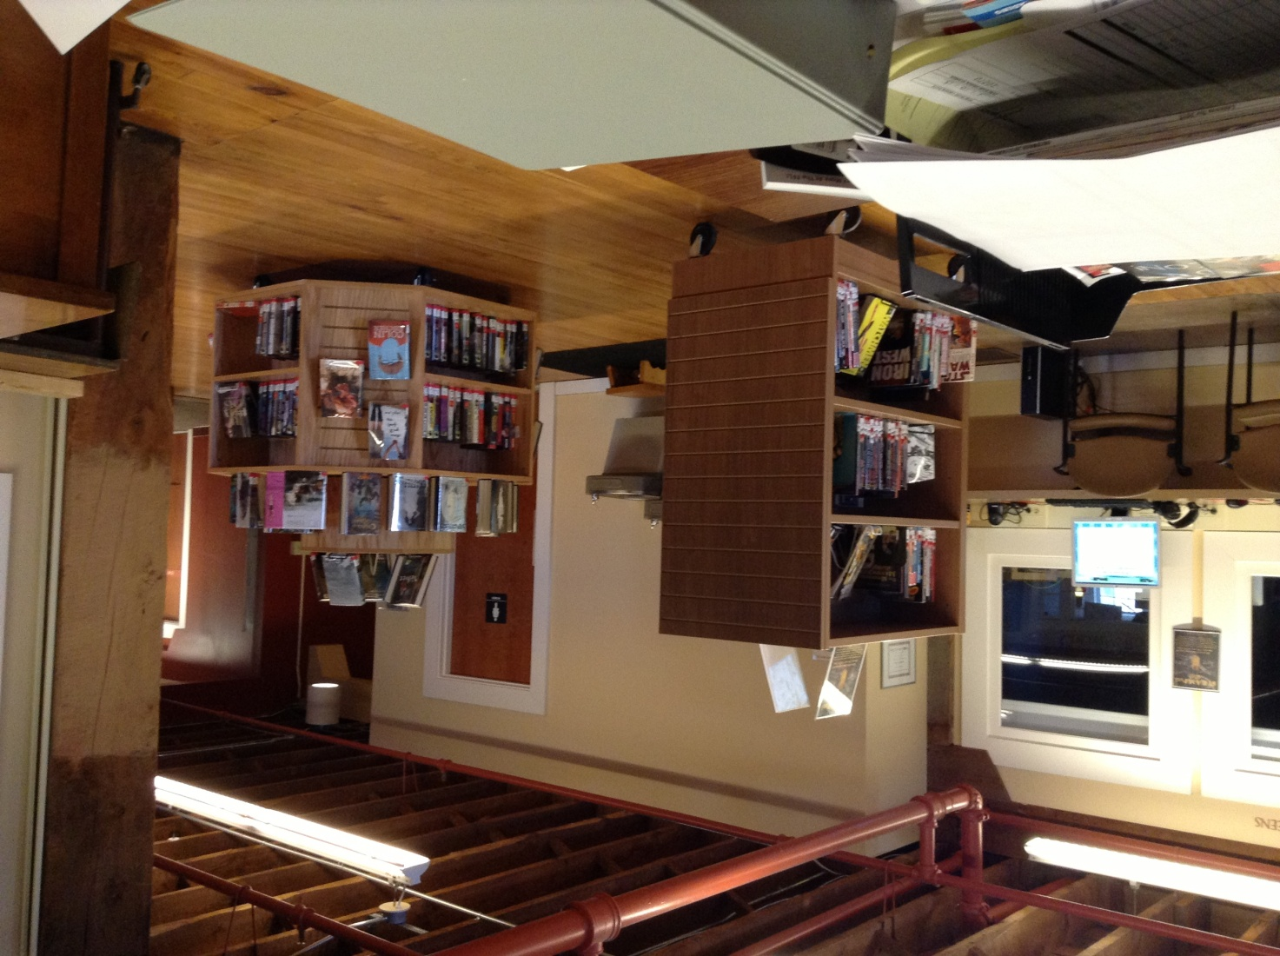
Collections – Fiction
Maintain classics collection
Making sure collection matches curriculum
Increasing the number of historically accurate fiction materials
Increasing the size of the graphic novel collection
Picture books have Common Core Aligned labels
Notes:
Margaret:

Slide 9
Professional Development
To keep up with Common Core developments.

Slide 10



Professional Development
Webinars
Workshops
  by publishers highlighting their new nonfiction offerings
  School Library Journal Common Core webinar series
  NYLA School Library section offerings
  OCM BOCES Common Core workshops
Notes:
Attend as many webinars as possible, some of the information is repetitive but you can hear from the publishers about their new materials and how they align with the standards. School Library Journal does a great series on the Common Core. There is one on June 4th at 3pm titled Be the Change: Take the Lead on Standards: Common Core and More. There is a plethora of information in these webinars. If you are a NYLA member it is always beneficial to attend some of the Section of School Libraries section offerings especially around topics on the Common Core. Last year I attended the NYLA CE on Common Core and that was one of the best presentations I experienced on the topic. Attend the OCM BOCES Common Core Workshops for school librarians. Starr Latronica was there discussing titles that allign to the standards and you will hear from current school librarians and what they are doing in their libraries and how you can support them and students.

Slide 11

Professional Development
Staff Training
Professional Journals and Organizations
engageNY.org – NY state funded Common Core informational site for schools and librarians
FFL Common Core Learning Day
School Library Journal
VOYA
Join Professional Organizations
Notes:
EngageNY is a great resource as we mentioned that can be used as a guide for the standards when staff has a question or is asked about the common core from a patron. FFL Common Core Learning Day is something we plan to do again in the future to make sure public librarians are up to speed on what is going on in the schools. Continue to read SLJ and VOYA as this topic is touched upon frequently. Join professional organizations like NYLA and ALA and participate on committees and boards.

Slide 12
Programs
To enrich the Common Core learning experience.

Slide 13
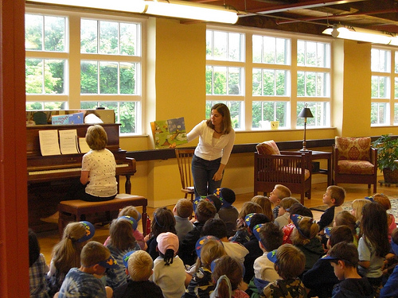
Storytime
5 Storytimes per week
  Ages 0-1
  Ages 1-2
  Ages 2-3
  Ages 4-5
  Musical Family Storytime
Early Literacy Skills
iPads
Music, Movement & Repetition
Creating life long library users
ELA Shift 1 Balancing Educational Literacy Text
ELA Shift 3 Staircase of Complexity
ELA Shift 6 Academic Vocabulary
Notes:
Meredith: Storytime is the eye opener for young learners even before they walk, an effective storytime can make a significant impact that will get students ready for school. Storytime helps with physical development and health as well as social and emotional development. It increases children’s communication and literacy skills and introduces them to the world of math, science, technology etc. and creating a love of libraries and life long readers. The early literacy skills that we teach in storytime will create young learners who are more aware of their surroundings and ready for kindergarten. We use iPads in our storytime to incorporate different kinds of learning, touching, hearing and seeing actual images and sounds that relate to the stories we read. Music, movement and repetition create the developmental, emotional and social skills for children. We use at least one nonfiction title in our storytimes and ask lots of questions about the book to align with the ELA Shift 1. In storytime we read books that might be a step higher then normal, creating a staircase of complexity. This intertwines with the academic vocabulary shift by introducing new words in each storytime and discussing what they mean.

Slide 14
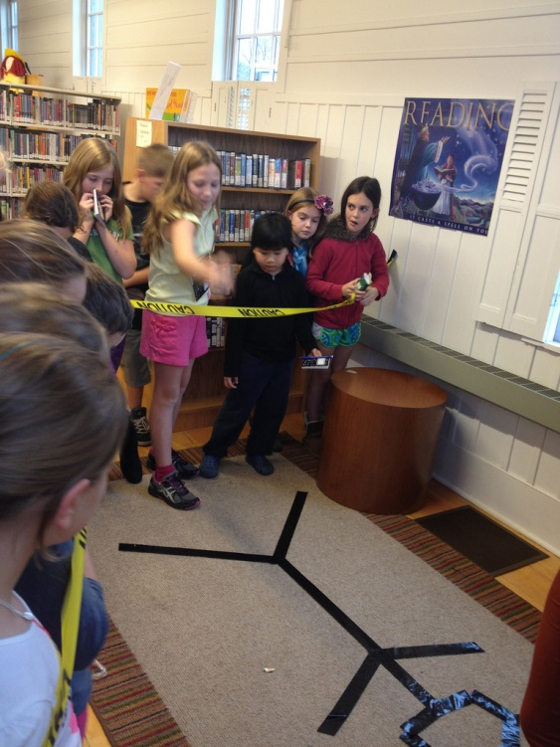
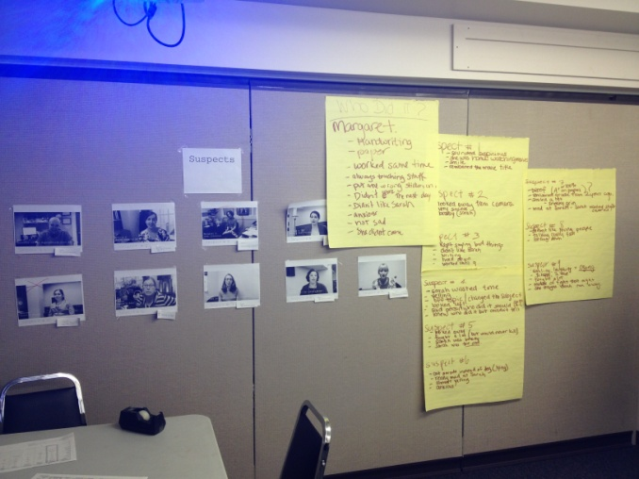
Murder Mystery in the Library
Winter Break Program for school aged children
Evaluation of evidence
  Handwritten notes, video interrogations, actual crime scene clues
Comprehend information and critique
ELA Shift 4 Text Based Answers
ELA Shift 5 Writing from Sources
ELA Shift 6 Academic Vocabulary
Notes:
Meredith: This program was for school aged children and tweens during last year’s winter break. I filmed 9 people on staff for interrogation videos and planted evidence around the library including a crime scene and handwriting samples. Each kid got a spiral notepad and pen and had to take notes on all of the evidence and come to a conclusion via teamwork and discussion on who committed the crime. We took notes on big paper on each subject based on the various types of media that they analyzed, therefore writing from sources and creating text based answers. I made sure to use real terms such as evidence, interrogation, suspects to increase academic vocabulary and put the vocabulary into context. Patrons had to comprehend all the information given to them and critique what was presented. Margaret ended up being our number suspect and we made a successful arrest!

Slide 15
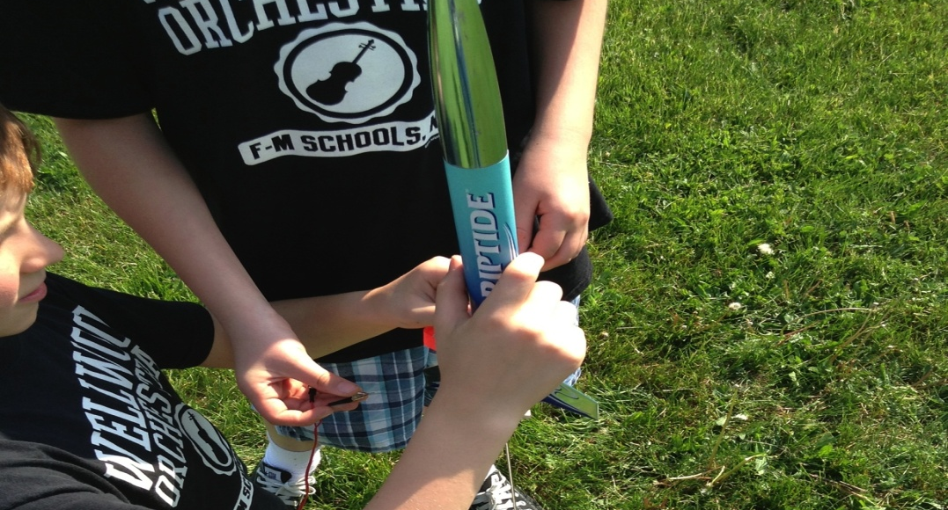
STEAMPunk Club
Each month sponsored by a steampunk YA novel
Book discussion
Hands on projects
  Hot air balloons
  Salt water and air batteries
  Wind turbines
  Takeapart
  Skeletons
  Rockets
Shift 1 Balancing informational and literary text
Shift 2 Knowledge in the disciplines
Math Shift 2 Coherence
Notes:
Margaret:

Slide 16
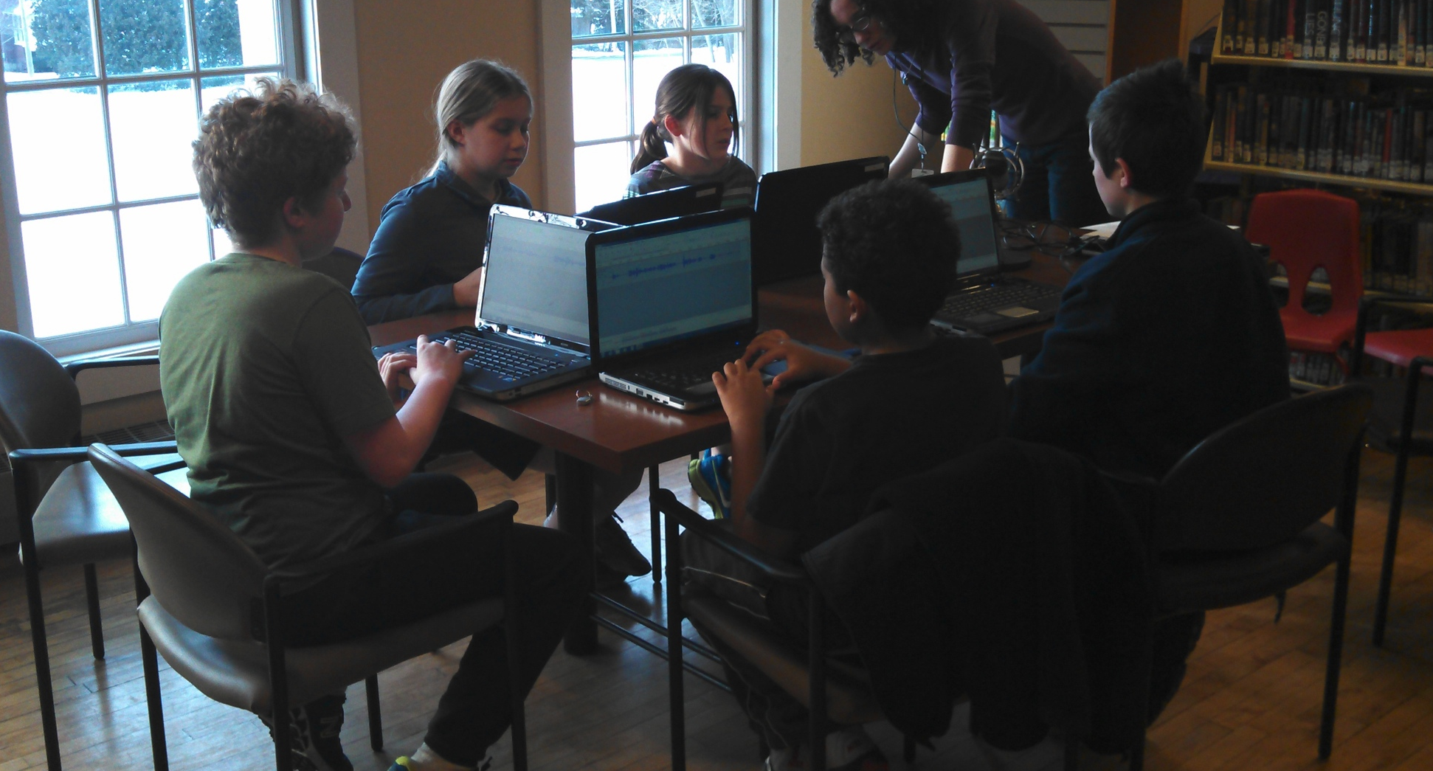
Creation Club
Afterschool club for middle school aged students
Each month there is a workshop teaching a new skill or use of technology in the Creation Lab
Club Creations are shared on the library website and social media outlets
ELA Shift 2 Knowledge in the disciplines
Math Shift 5 Application
Notes:
Margaret:

Slide 17
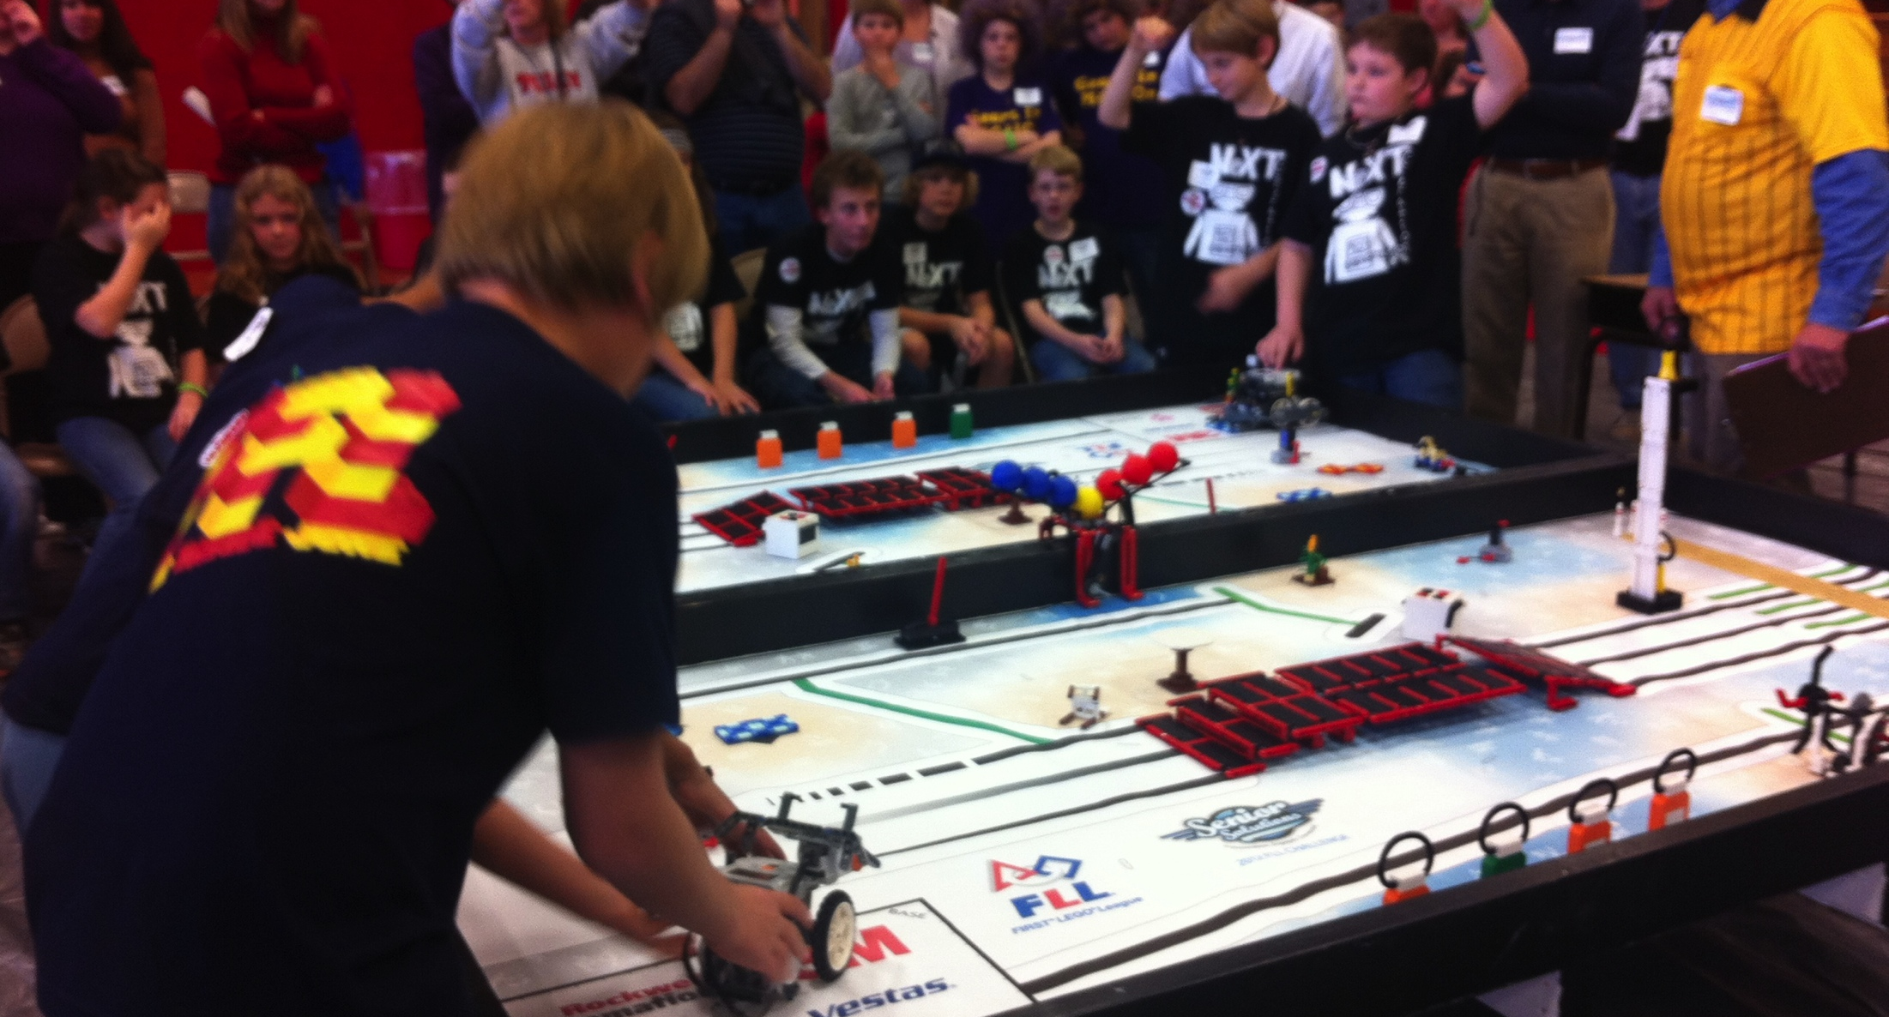
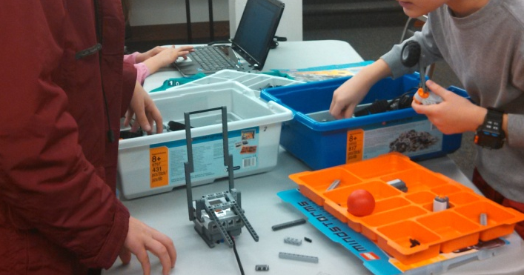
LEGO Robotics
First LEGO League
Mission:LEGO
Math Shift 5 Application
Math Shift 6 Dual Intensity
College and Career Readiness Use Technology and Digital Media Strategically and Capably
Notes:
Margaret:

Slide 18
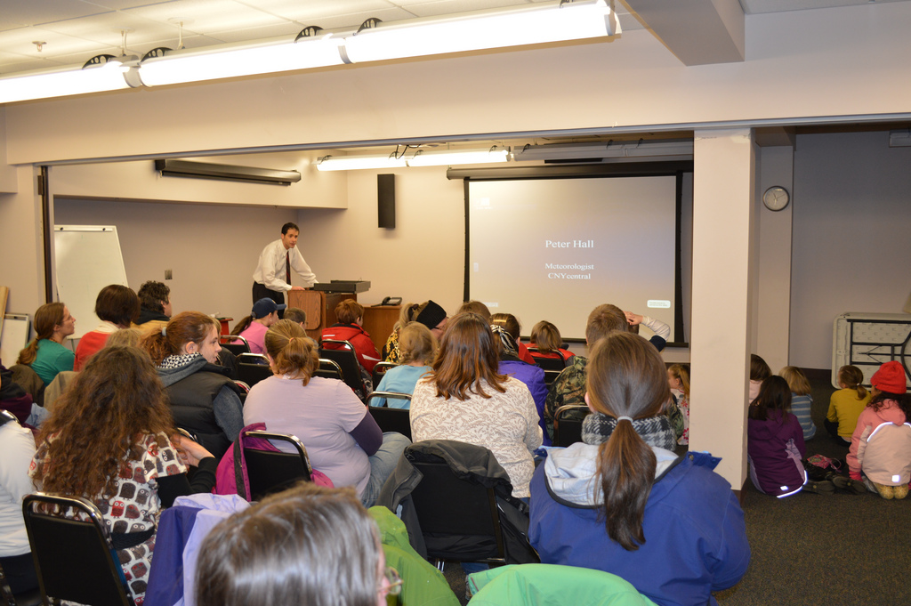
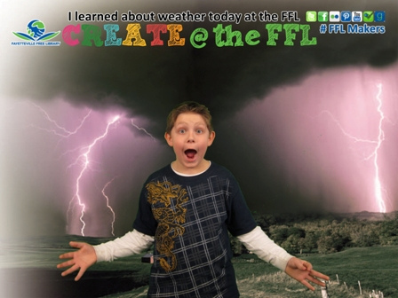
Extreme Weather
ELA Shift 2 Knowledge in the Disciplines
ELA Shift 6 Academic Vocabulary
College and Career Readiness Use Technology and Digital Media Strategically and Capably
Local TV meteorologist talked about meteorology and television broadcasting
Used green screen wall to make kids into Weathercasters
Notes:
For winter break we had local meteorologist Peter Hall at the library before a group of 75 plus patrons. Hall discussed his job both tracking the weather and broadcasting on television. He discussed in great lengths about the weather and the science behind it, therefore aligning to the knowledge in the disciplines. He used a plethora of vocabulary used in the field. We felt that this also created a college and career readiness skill. Hall described how he does the weather in front of a green screen so we decided to use ours and Photoshop those pictures in front of something weather related, so children were using technology and digital media strategically to capture the essence of being a real weathercaster. We combined science and interest in career into one program.

Slide 19
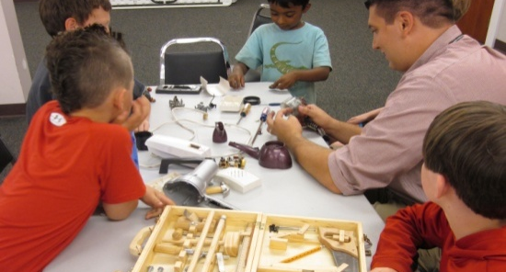
Takeapart Tuesday
Community donated broken and used technology
Bring Your Own Tool event
Patrons work together to take apart the machines and figure out how they worked
ELA Shift 2 Knowledge in the Disciplines
ELA Shift 6 Academic Vocabulary
Math Shift 5 Application
Notes:
Margaret:

Slide 20
More Programs
Now
Summer
Make Your Own Book
Minecraft
Smartplay
3D Printer Certification
Teen Volunteers
Young Scientists
MOST Museum (OCPL)
Zoo to You (OCPL)
Maker Mondays
Kids Can Cook
LEGO Angry Birds
Notes:
Meredith: Make Your Own Book is one example of our maker programs that we offer for school aged children and teens. This gives an opportunity for patrons to write from sources around the library and create a final product to take home. Smartplay is an early literacy play program that was developed by the FFL to create a space for young children and their parents or caregivers to come play, explore and learn literacy skills. The MOST program a hands on interactive approach to a real life subject, dirt and soil. ZOO to You again is another hands on approach.

Slide 21
What’s Next?
Questions?

Slide 22
Resources
www.fflib.org
www.engageny.org
www.corestandards.org
www.slj.com
www.voyamagazine.com
www.nyla.org
www.ala.org
www.ocmboces.org

Slide 23

Thank you!
For further information or to schedule an FFL Innovation Tour please contact:
Susan Considine
Executive Director
sconsidine@fflib.org
@sconsidine

