Slide 1

If not for the Library:
Discovery Through Making
Meredith Levine
Director of Family Engagement
Fayetteville Free Library
mlevine@fflib.org
Stephanie Prato
Creation Lab Intern
Fayetteville Free Library
scprato@syr.edu
@scprato
#FFLMakers
Notes:
We are using the hashtag #FFLMakers as a new community engagement tool providing an opportunity for our patrons to share what they are making, want to make, or have made with other #FFLMakers.

Slide 2
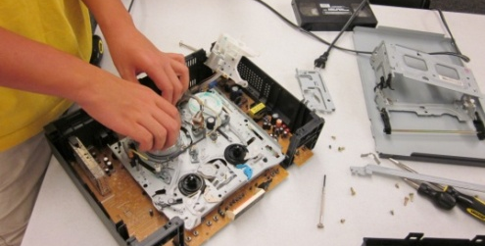

Library Makerspaces
What is a makerspace?
What do they do?
Notes:
Ask audience, what do you know about makerspaces? What are they?
Makerspaces developed out of D.I.Y. culture. They are places where people with common interests can come together to create and collaborate, share resources and knowledge, and STUFF--like tools and technology needed to make things; whether that is digital content, physical media, electronics, art, video games, or something else.
Traditionally, makerspaces, also known as hackerspaces or tech shops, have not been freely and openly accessible to the public. Often, you might have needed to be enrolled in a specific program at a university to access one, or if you are lucky enough to have one in your community, you needed to pay membership fees or dues.
At a basic level, library Makerspaces provide free and open access to information, ideas and tools that people typically have to pay for, and they bring people together to share ideas and create learning opportunities. They give people tools to create, to hack, to remake their world for the better.
What we do as public libraries is provide access to tools, content, technology, spaces, and each other. Makerspaces are a new way that libraries can create even more of these opportunities. Library makerspaces provide free and open access to the tools, equipment, and people to enable our patrons to transform their lives.

Slide 3
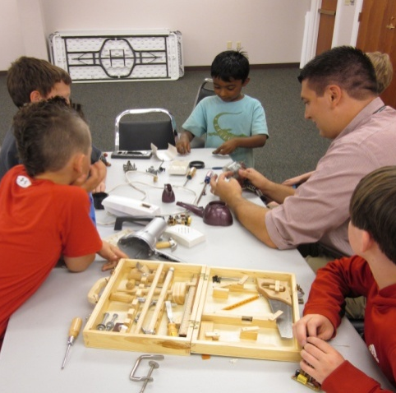
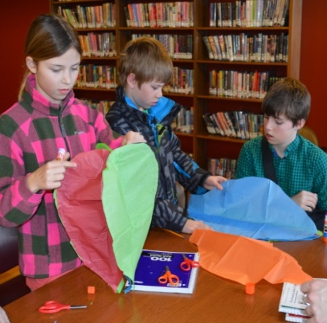
Why?
Unique Information Sharing
Learning Opportunities
21st Century Literacy Skills
  STEAM Literacy
  Digital Literacy
Common Core Learning Standards
Notes:
*Why makerspaces in libraries?
*As librarians, we are in the information and learning business. Makerspaces, quite simply, allow for unique information sharing and learning opportunities. They offer meaningful peer-to-peer learning experiences; they encourage learning by playing, doing, tinkering, and making.
Indeed, this is another important aspect of library makerspaces – they support 21st century literacy skills, such as digital literacy and STEAM literacy (which is an acronym for Science, Technology, Engineering, Arts, and Mathematics) and the Common Core Learning Standards.
As it’s pretty clear to us, recent technological advances have strikingly changed the way we interact with each other and our environments.
Technology is becoming more complex and more prevalent
Especially important that children develop these skills
They grow up with technology
Their growth will be limited to what already “is” if they do not learn how to create what “isn’t yet”
We need to recognize that it is no longer enough to simply provide our community with information material for consumption. Instead, we can remain vital by supporting a read-write culture in our communities, providing opportunities for community members to learn and share openly with one another. If we can recognize that our community members are experts, we can play a crucial role by providing them the tools and opportunities to share their own expertise.
In schools you can do this by identifying staff members and even students with interests and expertise and collaborate with them to use the library as a makerspace.

Slide 4
Our Mission and Access
The mission of the Fayetteville Free Library is to provide free and open access to ideas and information
Our philosophy is to provide free and open access to:
Content * Technology * Spaces * Each other
To help community members transform their own lives.
Notes:
At the Fayetteville Free Library, our mission is to provide free and open access to information and ideas. We understand that our mission doesn’t change, but the community’s needs change. So as libraries we need to build into our practice flexibility in allocation of resources, budgeting, and service planning to be able to respond to the community’s needs today.
In 2011, we began to understand that making is part of our mission. Once we understood that, we determined this was an evolving service priority. So we did what was necessary when introducing any new services. We built buy-in and support at stakeholder and staff levels.
We had conversations with the community to learn what our community is interested and passionate about. We wanted to know more about what they could do, what they could share, and what they wanted to learn. With buy-in from the stakeholders and staff, we took our understanding of the community’s dreams, desires, and interests and used them to inform our program and service development.
You can have these conversations in meetings with staff members in your school community and talk to your students as well to see what they are passionate about and what they want to learn. Giving ownership of your library makerspace will create buy in to the idea.

Slide 5
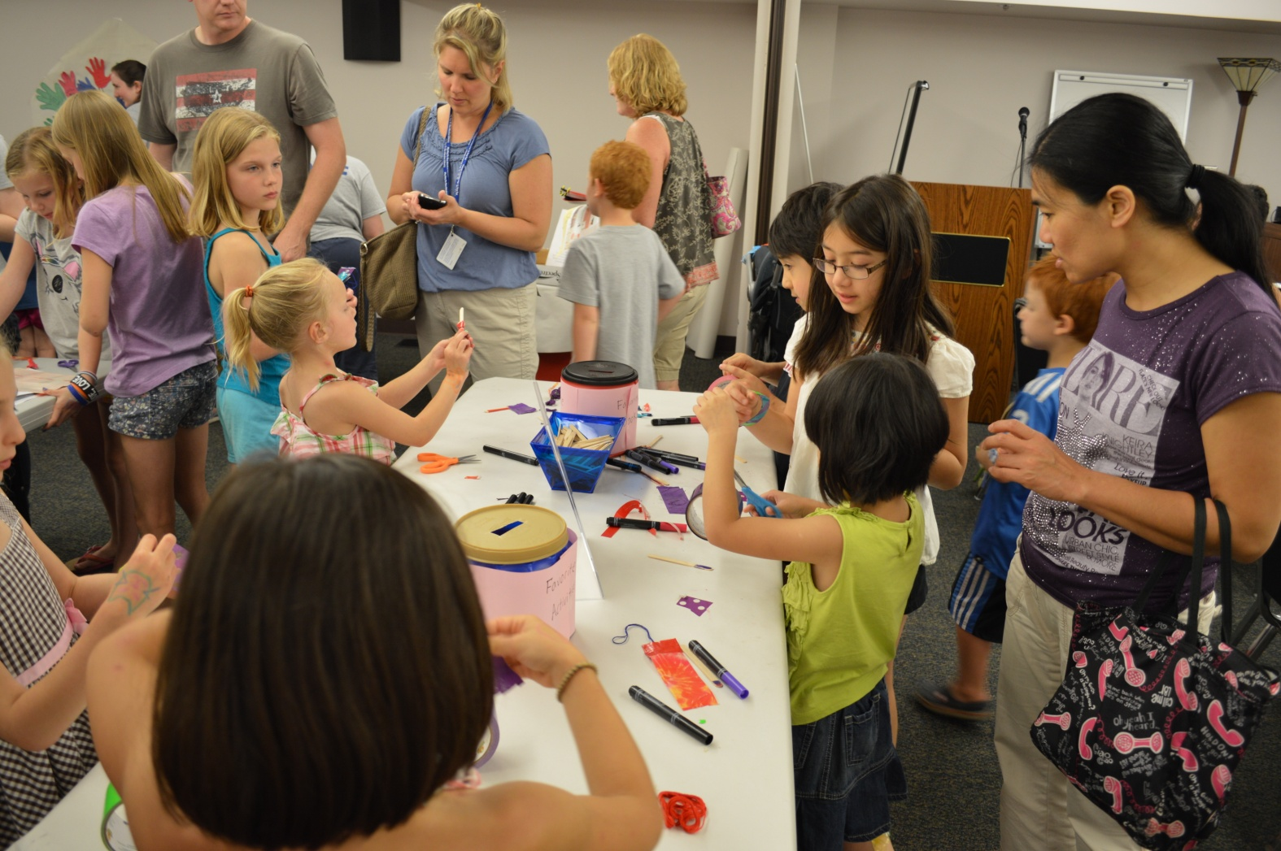
Culture of Innovation
What is it?
How do you create it?
Notes:
As we will discuss, it doesn’t take as much as you might think to create a library makerspace. However, one crucial component is that the library needs to develop a culture of innovation; one where risk tolerance is high and administration support is essential.
At the Fayetteville Free Library, risk taking is encouraged – it is okay to propose an idea that may seem out of left field, it is okay to fail.
The culture of innovation of the Fayetteville Free Library is one of the main reasons we were able to innovate relentlessly including adding disruptive technology and introducing making into our services.
Staff members at the FFL are expected to bring new ideas to the table, and from there, collaboratively, ideas develop.
Staff are given time to innovate and come up with Big Ideas. For instance, at the FFL, we have monthly staff forums, which are basically hour-long brainstorming sessions for developing new, innovative programs and services. We have found that staff members need to have time for brainstorming and collaboration built into their schedule.

Slide 6
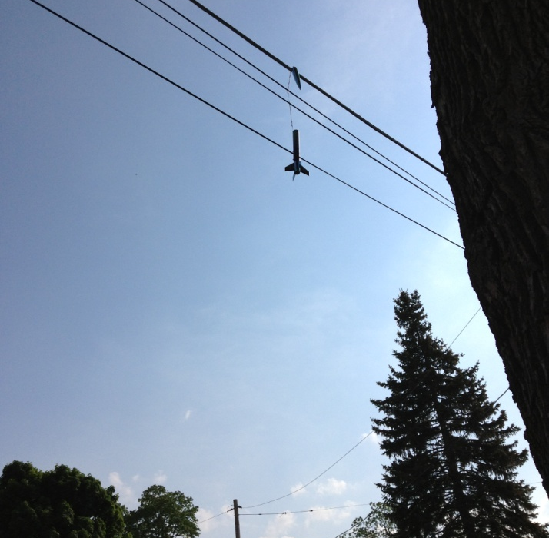
Barriers to Innovation
Funding
Decision Makers
Space
Safety/Liability
Notes:
When thinking about bringing making into your library, there are 4 main barriers that we hear time and time again.
-Funding – we don’t have it in our budget to buy X or Y big piece of equipment, for instance. Funding - we were successful in funding our maker programs through assessment of our current programs and services. We took note of those services that were being under utilized and reallocated those funds to programs that our patrons were finding more value in. We also applied for grant money. Many organizations offer awards and opportunities for STEAM learning and other innovative programs and spaces.
Decision makers - we can’t get the buy-in from our administration/board/etc.
Demonstrate to your board and your director that making is an essential part of your library's mission. At the FFL, our makerspaces are tied to our commitment to providing free and open access to ideas and information.
Space - we don’t have anywhere in our library to put a makerspace
Constant evaluation
You don't need to completely renovate a space in your library to start making. You probably already have a multi-purpose room that may be used for everything from community meetings to children's story-times; there's no reason making can't be an activity that happens in that space too! Also consider repurposing a dark corner of your library that might not get as much foot traffic, and make the most out of the spaces you have.
-and finally – Safety/Liability issues – offer an incentive to get training. You’re covered by insurance. Making sure patrons are aware of the dangers. Know what your insurance policy is and how it applies to your patrons and their usage of the equipment.
We’ll talk a little bit now about the makerspaces we were able to develop at our library, and in doing so, hopefully we can shed light on ways we have found to overcome these barriers.

Slide 7
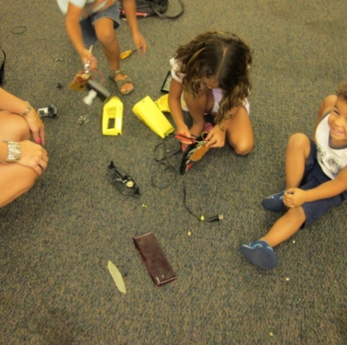
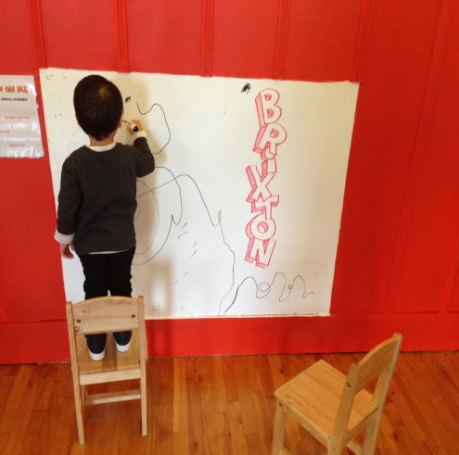
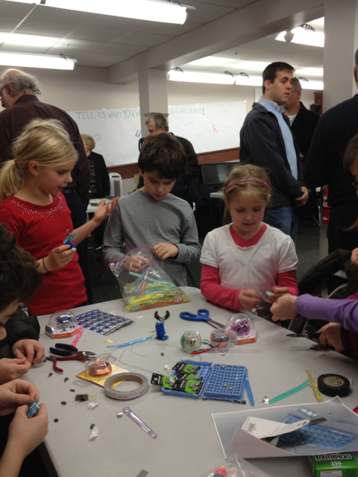
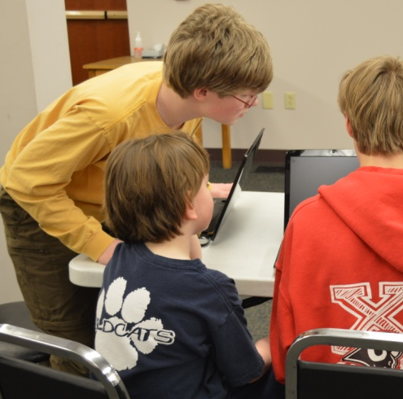
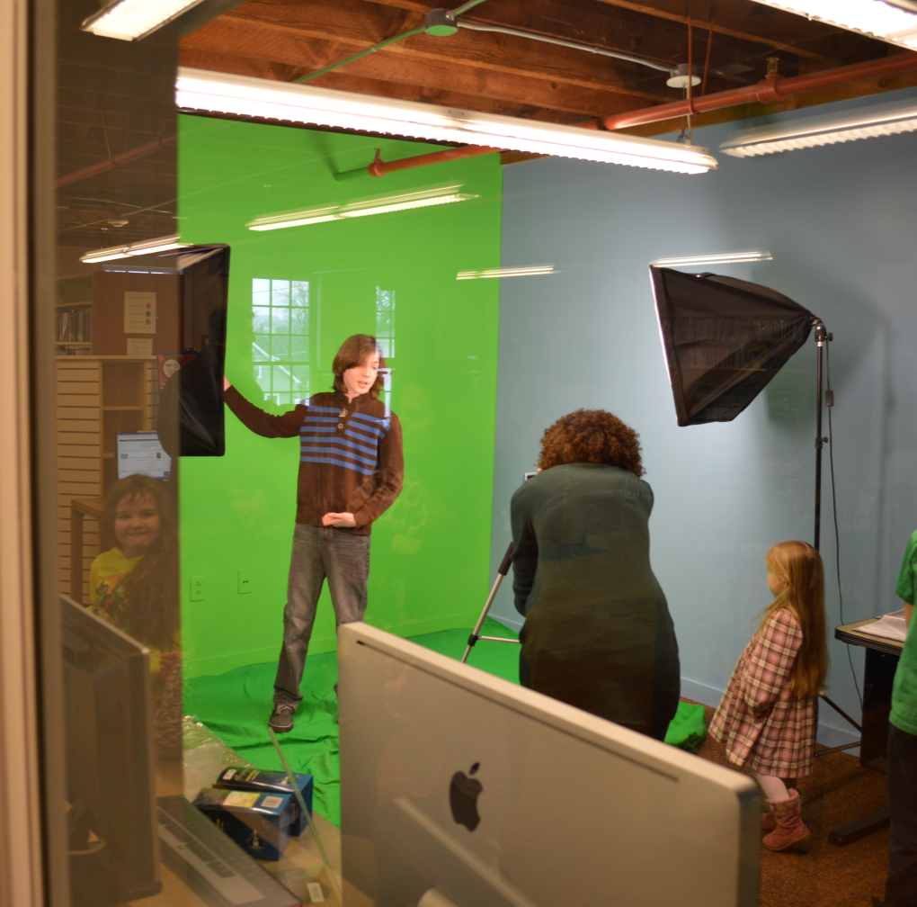
FFL Makerspaces
Space-free making
FFL Creation Lab
FFL Fab Lab
FFL Family Room
Little Makers Area
Notes:
Our first incarnation of making in our library took the form of space-free learning opportunities. Essentially, we used our existing Community Room – a large meeting room - to host programs and events where community members were invited to come into the library and make things. To this day, we continue to use our Community Room for many maker classes, programs and events such as SketchUp classes, sewing classes, Lego Mindstorms competitions, and more. So, just because you don’t have room in your library for a brand new makerspace doesn’t mean you can’t do making at your library.
Some of our first maker programs held in our Community Room also include Maker Open Houses, where we set up the Community Room into stations, where you can make something different at each station. At these Maker Open Houses, for instance, we’d have open source 3D design software available to use on laptops in the center of the room; a Makerbot 3D printer donated by a local print business operating in one corner of the room; duct tape art in another corner, orange juice making in another corner with a donated hand juicer, and more.
Attendance and community interest in these initial maker programs was overwhelming. As a result, we decided to take the next step and repurpose an existing space – a tutoring room in the library – to become the FFL Creation Lab. The goal of the Creation Lab was to provide increased access to the tools and technology needed for making things (so that people could use these tools on their own time, independently). The lab consists of tools for such as podcasting, photo editing, and video editing softwares, a green screen, and more. It is also became temporary home for our 3D printers, so we didn’t have to wheel them out of storage any time we wanted to have a class or program or for a patron to use them. Again, developing this lab involved repurposing an existing space that we already had in our library. We were able to get decision makers on board easily because our community had already clearly displayed their interest in making, coming out in huge numbers for our first maker programs and giving us tons of feedback at these programs about different things they were interested in teaching and learning about making at the library.
Now, we are currently in the process of developing an additional, larger space to serve as a permanent home for our fabrication tools and technologies. This lab is our FFL Fab Lab. In terms of the funding barrier– we were able to renovate this space because we were awarded a grant to do so. Our goal is for the Creation Lab to provide access to resources needed for digital content creation, while the Fab Lab will be a place for community members to come together and share the expertise and resources needed for the fabrication of physical objects.
FFL Family Room - is an example of a space that was underutilized. It is a room off the main children's room that was used primarily for storytimes, but was lonely the rest of the time. We added some new play features that support early literacy and hands on creativity and threw the doors open for families to play anytime. Now the room is always buzzing with children playing and laughing.
Little Makers Area - Little Makers is a free play area with attached programs and activities that are designed to encourage children ages 5-8 to imagine, create, and build. The supplies and technologies provided in the space encourage the development of critical thinking, STEAM skills, and transliteracy competencies.

Slide 8
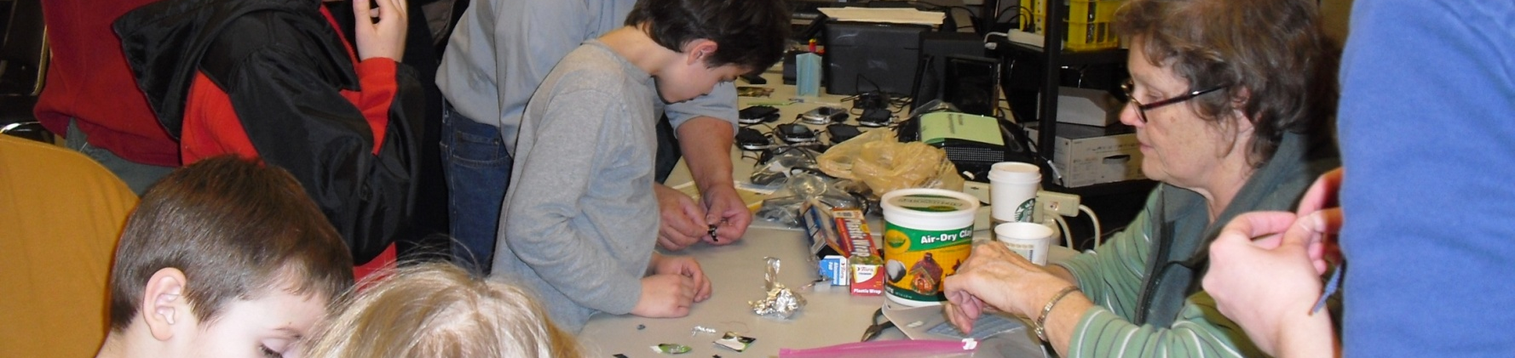
Community Engagement
The communities needs, desires, and aspirations TODAY inform our planning and services.
The community drives the library agenda.
Notes:
We knew there was an interest in sewing in our community, because there is a quilting club that meets to hand sew in our community room, each week. So we decided to support and develop this interest in our community by purchasing sewing machines for the FFL Fab Lab. Every month, our PR department creates an bathroom newsletter, a one page flyer called "In the Stalls" that we post on the doors. As a last minute filler, we decided to mention that sewing machines and classes would be coming to the FFL, soon. The next thing we knew, there were questions at our Reference desk about where the sewing classes would be, calls to PR about patrons volunteering their time to teach the classes, and donations of supplies and materials at our circ desk! And at first, we couldn't figure out where everyone had heard the news! (In the bathrooms, of course.) This demonstrates how enthusiastic the community can be and how willing and eager they are to help, when you can tap into their passion and ask the community to get involved.
For School Librarians: This may be a great opportunity for collaboration with teachers, who are an important sector of your community. Making generates curiosity and excitement for learning and supports what teachers are doing in the classroom, by reinforcing that information outside it. Also, try and find ways to engage and involve parents!
*The key piece is listen to your community when developing any and all service plans –makerspaces included. What types of things do your community members want to make? What types of skills do your community members want to learn? Let formal and informal conversations inform you about the expertise and passions your community members have. Informal conversations like this can happen every day over your service desks. We created opportunities for more formal conversations like this to happen by setting up our Maker Open Houses, These conversations provided the direction for library staff to move forward with programs and services. We found many people in the community that were eager to volunteer their time to share what they know and teach these skills. For instance, one volunteer who formerly worked as an engineer is now offering regular staff & patron training courses on Sketchup, a 3D design software. We had several volunteers come forward offering to teach sewing classes to the public. So, we are providing the tools and spaces for making to happen, but the community members are ultimately leading the direction of this service by contributing their expertise and sharing what they know.

Slide 9
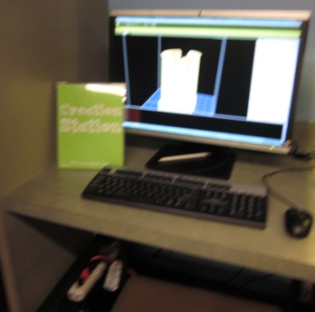
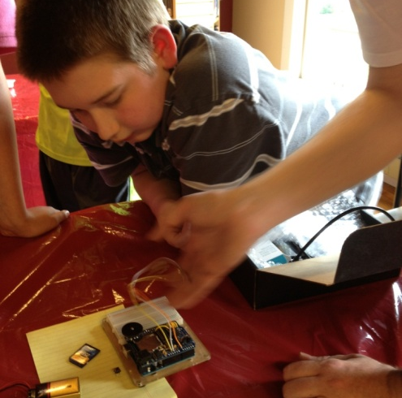
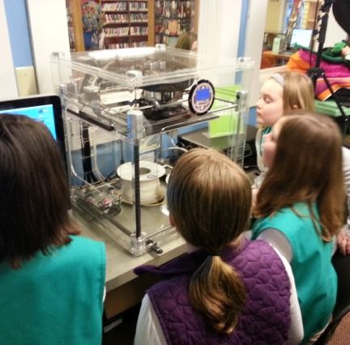
Tools and Tech
FFL Creation Lab
  Green screen
  Podcasting station
  Photo & video editing software
  Video cameras
FFL Fab Lab:
  Sewing machines
  Vinyl cutter
  Hand tools
  3D printers
  ?????
Notes:
For Schools: emphasize digital literacy!
PC & Macs
Adobe Creative Suite (Photoshop, InDesign, Illustrator)
Audacity (podcasting)
Sketch-up
*The beauty of the Maker movement, particularly in the library, is that there is no set list of equipment or tools required to make it a space successful.
*This is a list of examples of tools that we have available in our labs. What’s next? Whatever your patrons can dream up!
*In terms of the safety/liability barrier – as with anything else in your library, you need to have policies in place to protect you. You can develop waivers and agreement forms that you make patrons sign before accessing your lab or certain equipment. You can make patrons attend a training course before using a certain piece of equipment. Remember, we are not lawyers - seek legal counsel!

Slide 10
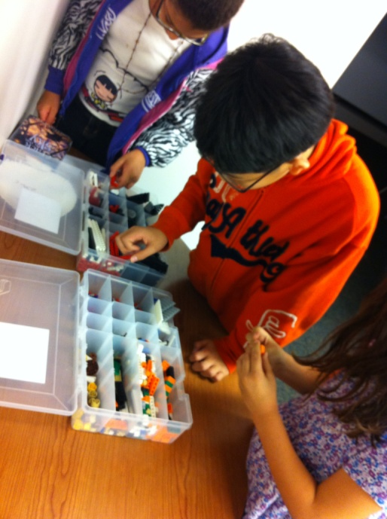
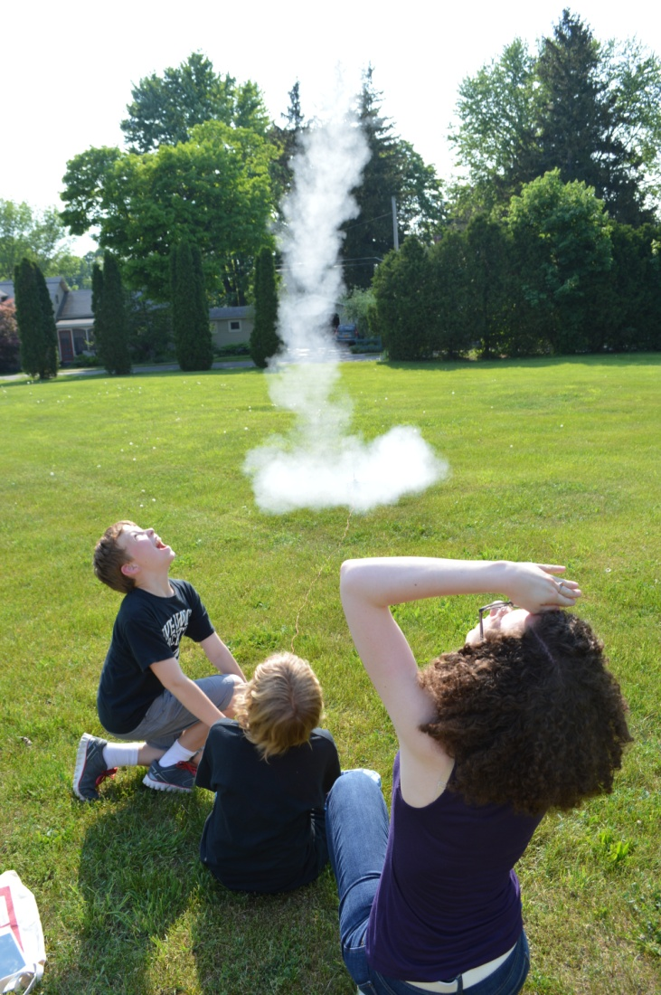
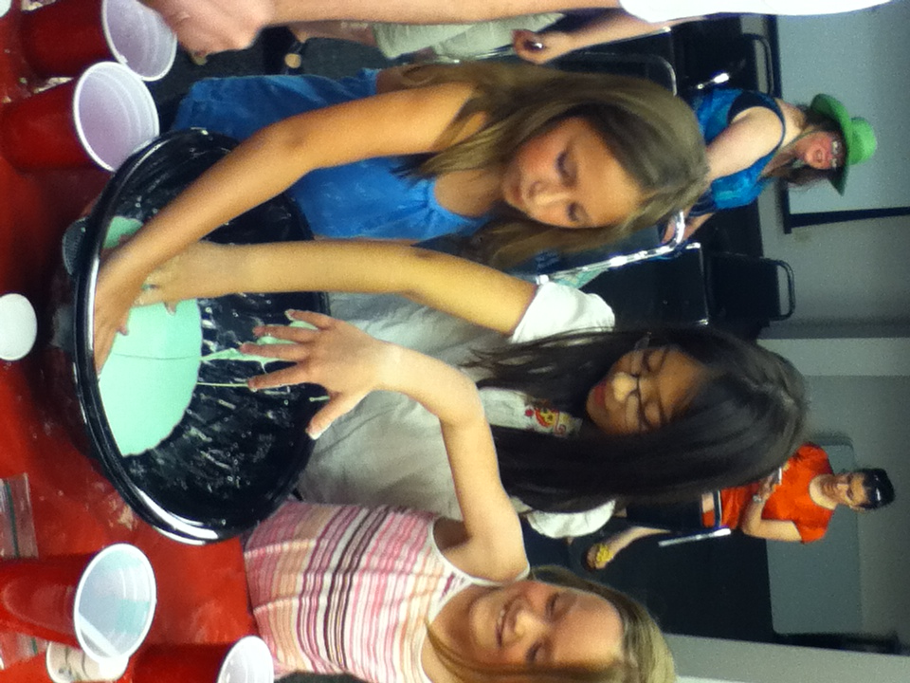
Programming Ideas
Take-A-Part Thursdays
Make Your Own Book
STEAMPunk Club
Creation Club
Lego Robotics
  First Lego League
  Mission:LEGO
Extreme Weather/Green screen
Podcasting
Notes:
Many maker programs you can run at your library are space-free, or could be done in your library’s community meeting room space.
Some of our maker programs include:
Take Apart Thursdays – where patrons take apart donated electronics, to see how they work (started in our Maker Open Houses)
Make Your Own Book – where kids take digital photos around the library and use them to make books (started in our Maker Open Houses)
STEAMpunk Club – part reading club and part science club; teens read and discuss steampunk books and engage in STEAM (science, technology, engineering, arts, and math) experiments relating to the books (Rocket example in the picture)
Creation Club – middle school afterschool club inspired by the Creation Lab; each month there is a short workshop on how to use one of the tools in the room and then free time to experiment and create and then share. This fall we will be launching Creation Club Jr. for grades 3-5
Lego Robotics – a patron suggested we start a First LEGO League Team so he could volunteer to help and spend more time with his grandson
First Lego League – International Competitive LEGO Robotics organization Kids are judged on design/build/program a lego robot, research project, teamwork. Many schools have hosted leagues before
Mission:LEGO – due to overwhelming positive response, we started this program to teach basic Lego robotics in a mission-based program. Some missions include Lego Gladiators and Lego Bowling
Extreme Weather – Local TV meteorologizt presented about meteorology, weather, and TV broadcasting; we were able to connect this real world example with our library makerspace using the green screen
Podcasting – A girl scout troop came in to earn a badge and wanted to celebrate Girl Scouts 100 year anniversary. In celebrating the girls recorded a happy birthday message at our podcasting station and sent it to Girl Scouts headquarters. We will took photos in front of the green screen and photoshopped them in front of the one of the 4 international Girl Scout lodges.

Slide 11
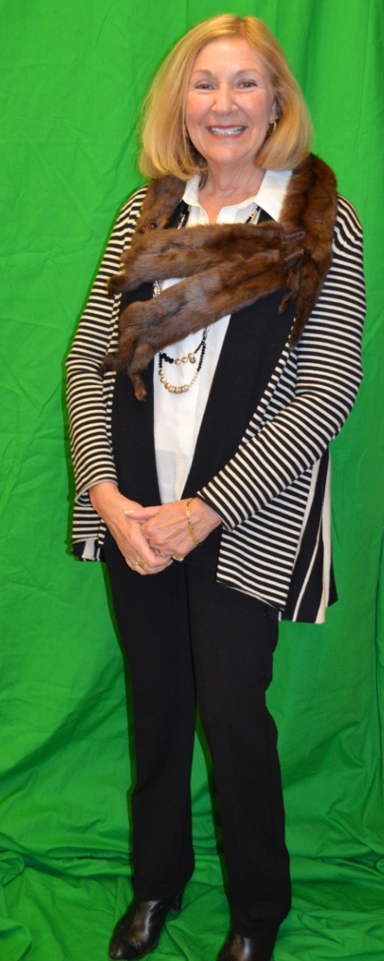
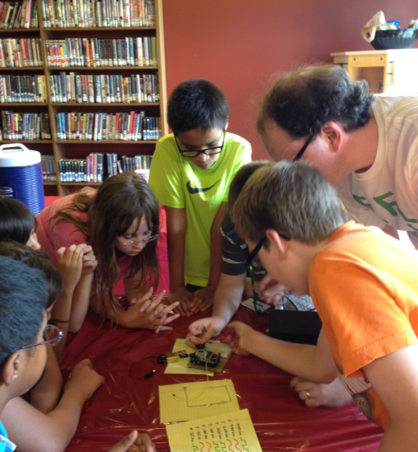
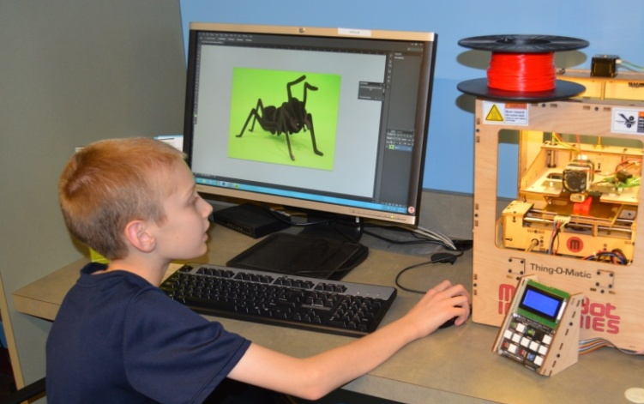
Programming Ideas
3D Printer Certification
Little Makers
Sewing Classes
3D Design software training
Maker Mondays
Adobe Photoshop
More Descriptions- http://fflib.org/makerfaqs
Notes:
Borrow-a-Bot programs – one-on-one sessions with librarian, where patrons become "3D Printer Certified“; gamifying patron training
Pinterest Craft Club –craft programs we offer for teens and adults where new and useful things are made out of old and defunct things, based on upcycling projects found on Pinterest
Sewing Classes and 3D Design software– taught by a community expert
Podcasting – example is a Girl Scout troop recording their favorite memories to send to the USA headquarters in honor of the 100th anniversary of Girl Scouts
Adobe Photoshop – example is green screen photography at events (photo of Nancy in front of green screen – actually Downton Abbey)

Slide 12
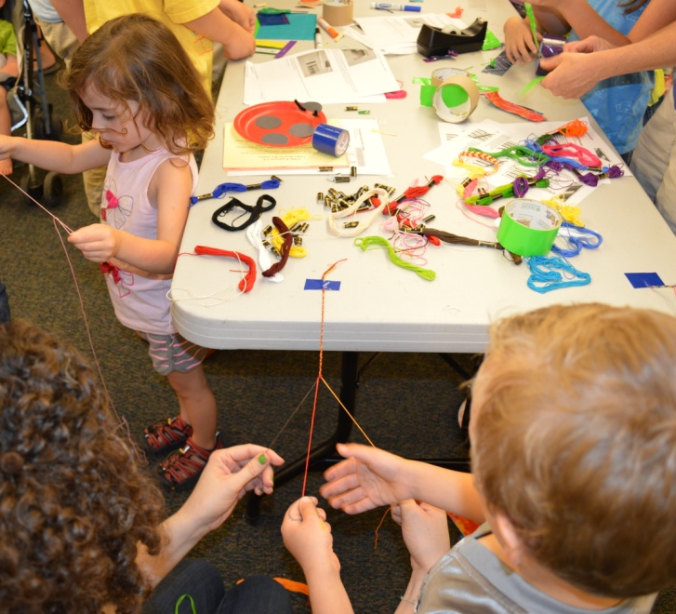
Conclusion
You’re already doing this!
Questions?
Notes:
As we’ve mentioned, library makerspaces support 21st century literacy skills, such as digital literacy and STEAM (Science, Technology, Engineering, Arts, and Mathematics) and the Common Core Learning Standards. These are the skills that enable people to understand and interact with the modern world. These skills also prepare them to make changes in the world around them.
Libraries are all about providing the access to the tools, resources, content, spaces, and people needed to discover, learn, explore and create. That’s what we already do!
* At a basic level, library Makerspaces provide free and open access to information, ideas and tools that people typically have to pay for, and they bring people together to share ideas and create learning opportunities. They give people tools to create, to hack, to remake their world for the better.

Slide 13

Thank you!
Fayetteville Free Library
Homepage: www.fflib.org
FAQs for Librarians: www.fflib.org/makerfaqs
Making! www.fflib.org/make
Twitter: @fayettevillelib
Facebook: www.facebook.com/fayfreelibrary
Susan Considine
Executive Director
Fayetteville Free Library
sconsidine@fflib.org
@sconsidine

