Slide 1

Reimaging Space
Meredith Levine
Director of Family Engagement
Fayetteville Free Library
Stephanie C. Prato
Creation Lab Intern
Fayetteville Free Library

Slide 2
SPACE
Notes:
Space will always be an opportunity and a challenge in libraries. Often, there is a limited amount of it, which can leave librarians frustrated when they work to add to their services. We will discuss how the Fayetteville Free Library has reimagined existing space that was either used minimally or for specific programming and how that space was changed into one of the most used and appreciated spaces in our library today.

Slide 3

ASSESSMENT
Notes:
At the FFL we are committed to continuous improvement through assessment. Every day we challenge our assumptions by asking ourselves, “what can we do better?, “what’s next?” and most importantly “What should we STOP doing?” This assessment is done, as a team, within our collections, programs and services and our spaces. We need to assess and evolve to provide the best access to library services for our patrons.

Slide 4
INNOVATION
Notes:
In order to be able to reimagine space, it is crucial that the library develop a culture of innovation; one where risk tolerance is high and administration support is essential. The culture of innovation of the FFL is one of the main reasons we are able to innovate relentlessly, including reimagining our services and repurposing our spaces. Team members at the FFL are expected to bring new ideas to the table, and develop them collaboratively.

Slide 5
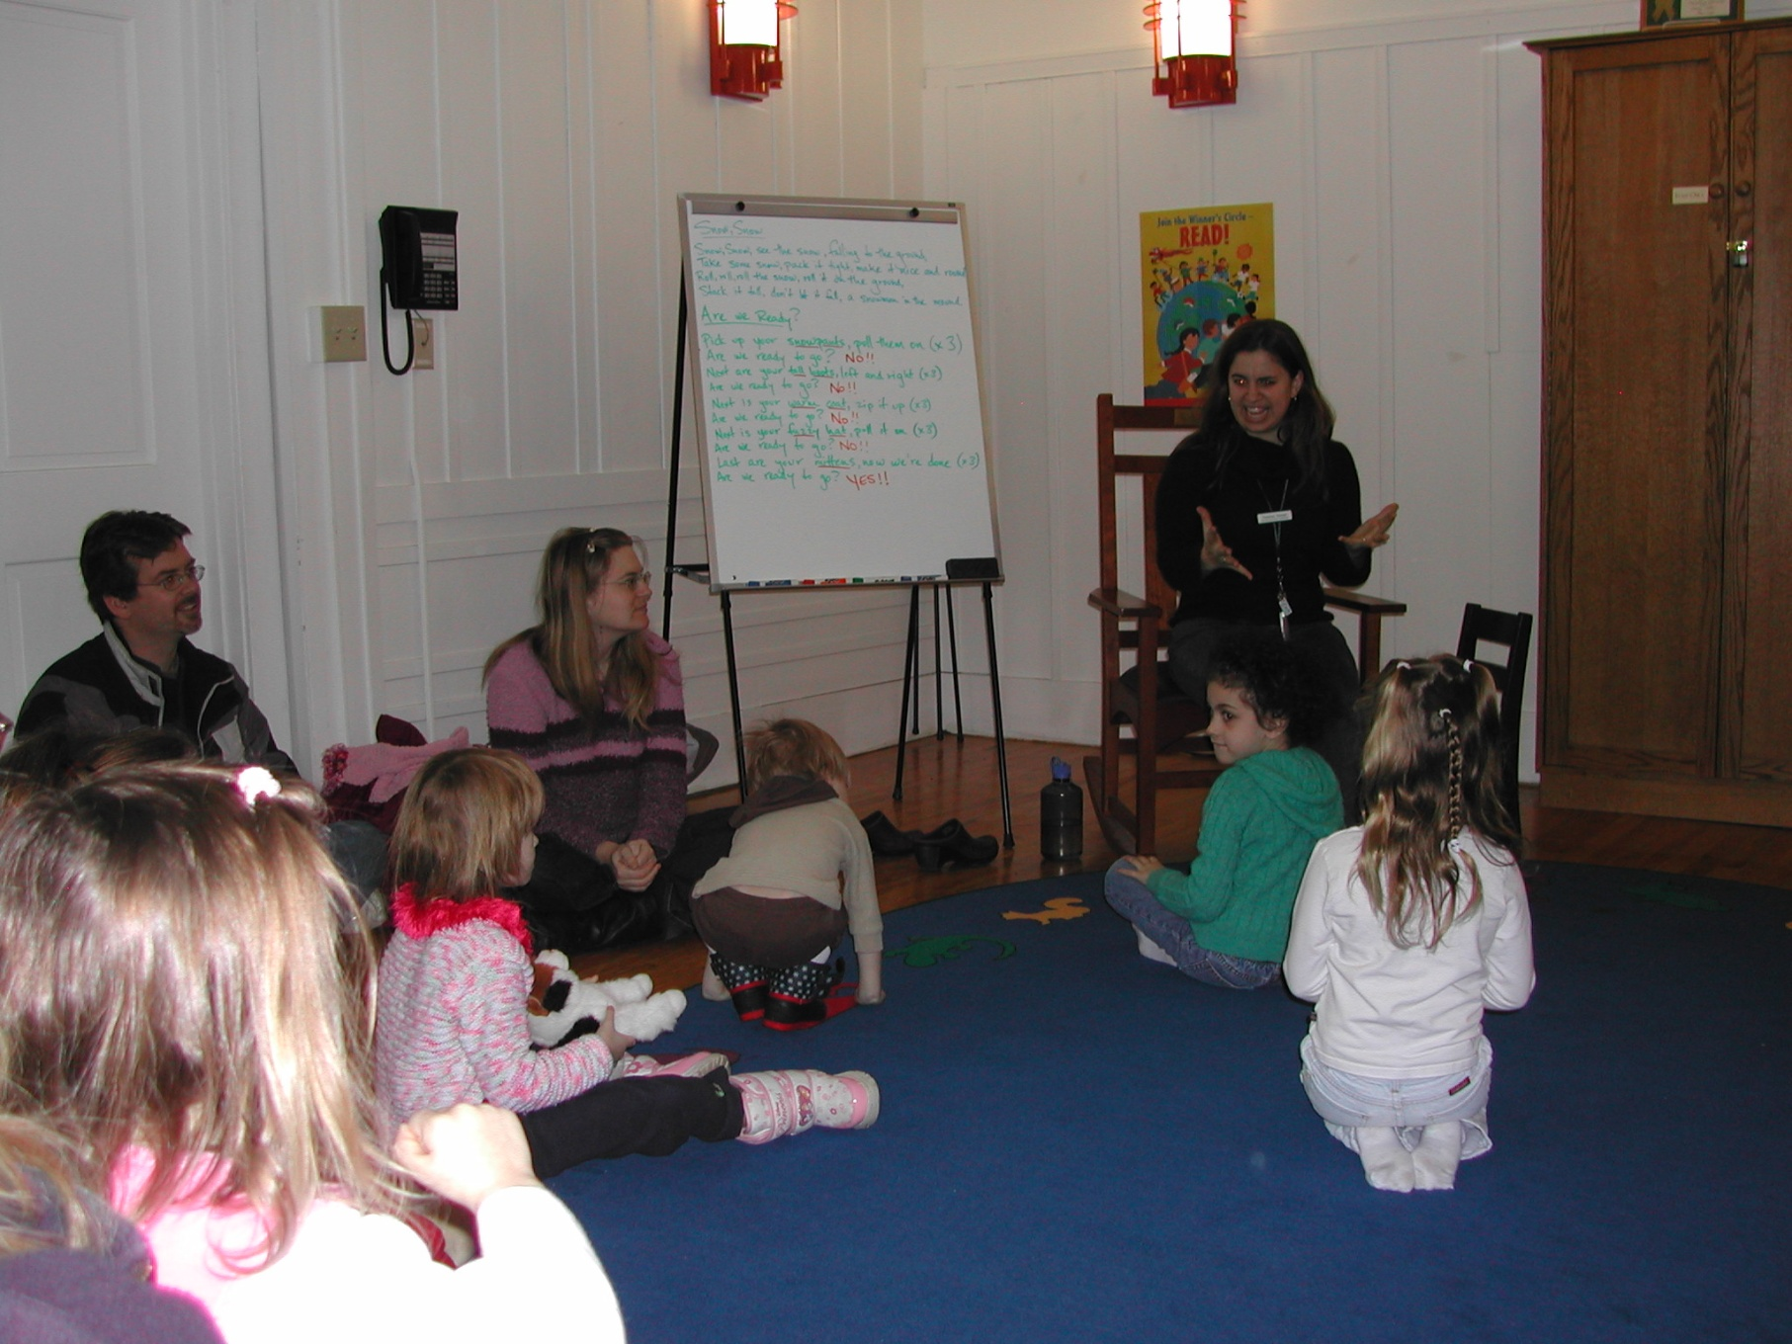
FFL Family Room Before
Notes:
Ml
The FFL Family Room before was used as the storytime room and had a desk in it used by a team member. The doors were only open when people were coming in and out of storytime. The space was only used for storytimes and community meetings. The space was large and under utilized. It was also uninviting with its doors constantly closed.

Slide 6
Reimagining
Notes:
Ml: So, the team at the FFL began to think together; “How can we rethink this space” and create a space that is accessible for children during all library hours? We did not want to have the doors closed or that space to be someone’s office. We wanted a space that was inviting, open, accessible, educational and fun for families of all ages. We want to create a room just for families….and through meetings and brainstorming, the FFL Family Room was created.

Slide 7
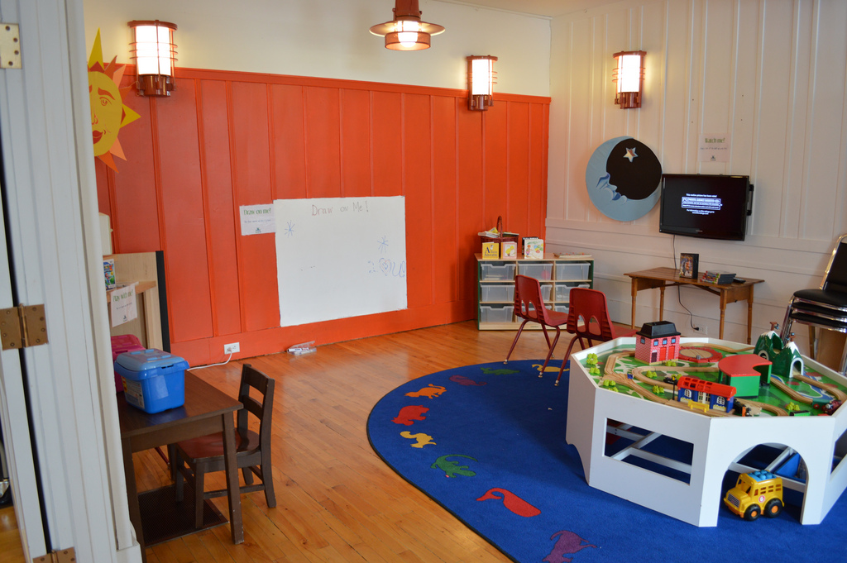
Notes:
Ml: An open, inviting space with doors that never close. A space with two wii’s with appropriate games kids enjoy. A train table for our younger patrons to have access to whenever they are at the library allowing them to play and interact with other children. Puzzles and a TV where patrons can play their favorite movie or listen to their favorite CD, developing early literacy skills through dance and movement. And finally the white wall, where patrons can imagine and create while writing on the wall.

Slide 8
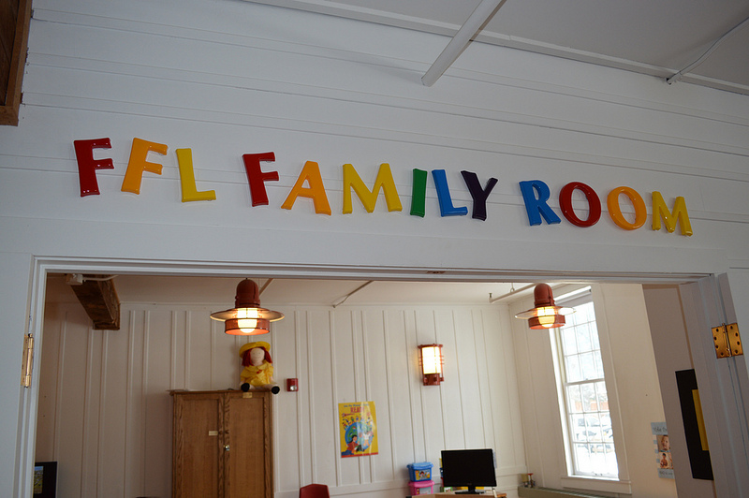
Notes:
Ml: This space has become the perfect place for play and early literacy development at any point during the day; before or after a library program. Kids are in here after school, during the day after storytime, or during a Library After Dark program with a babysitter. Parents are meeting each other while their children are meeting a new friend by using the FFL Family Room as the perfect meeting place. These doors in the FFL Family Room will never close.

Slide 9
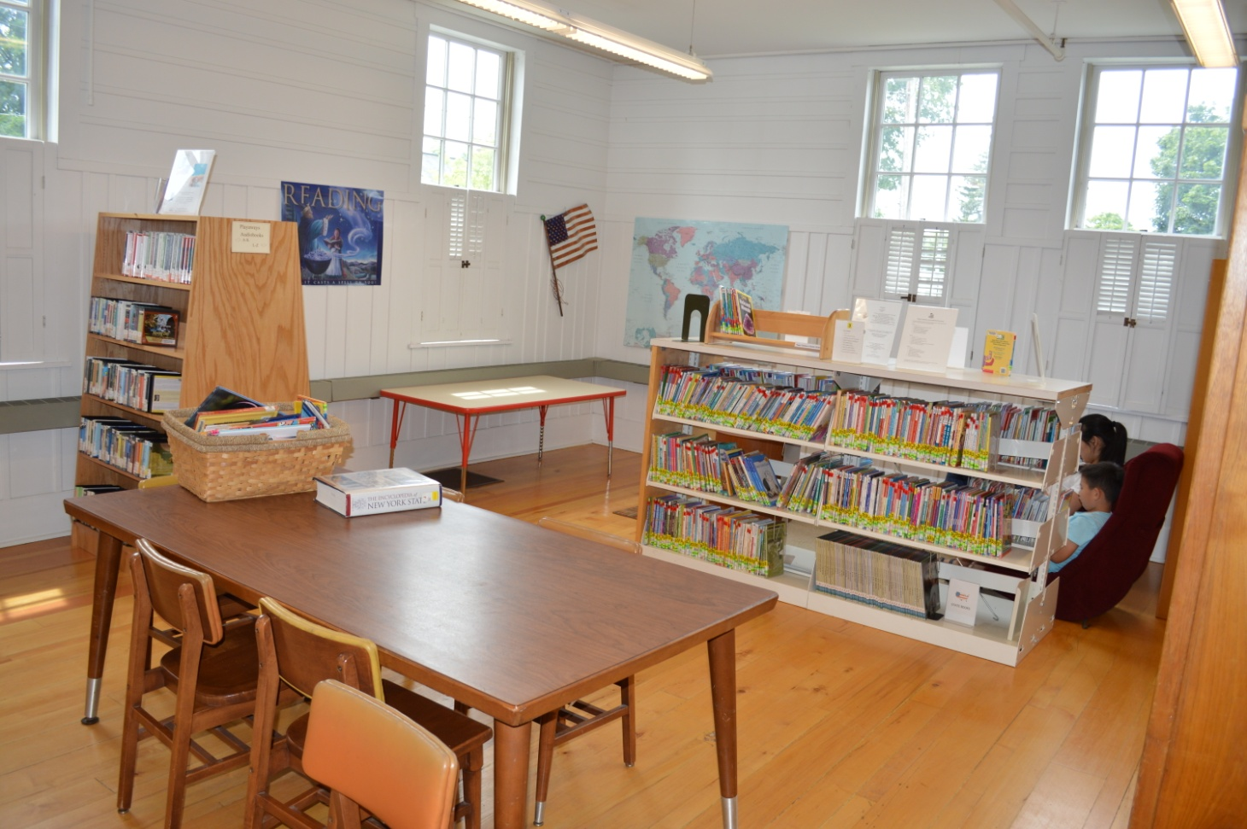
Little Makers Before
Notes:
Sp
This back corner of the children’s room was a under utilized space. There were several table and a few chairs that were seldom used by patrons. The position of the shelving unit that houses our readers also cut off the space and blocked sight lines across the room. In fact, unless they were looking for a specific book, most patrons forgot that this corner existed, all together.

Slide 10
Reimagining
Notes:
Sp
At the FFL we have a vision of libraries as centers of community creation, and we actively foster a culture of making and innovating. This culture should be encouraged and instilled in patrons of all ages, however, a gap in our services left young children without the space and opportunity to participate in maker culture. This space was the perfect opportunity to fill that gap.

Slide 11
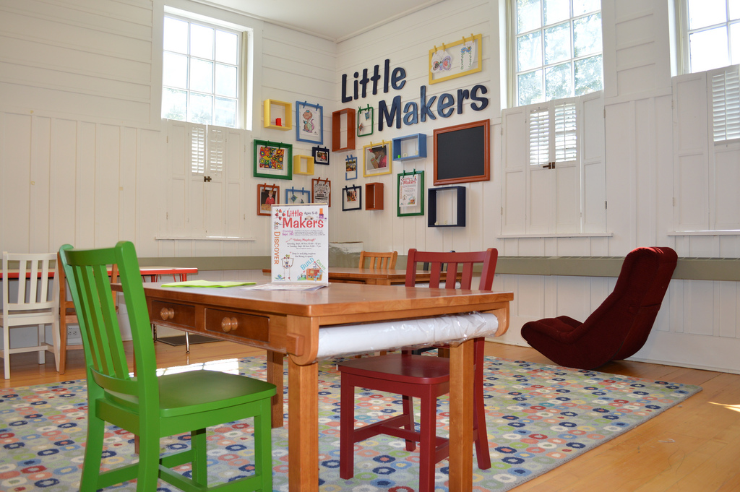
Notes:
SP
The Little Makers area is a free play space with attached programs designed to encourage children to imagine, create, and build. The supplies provided in the space help develop critical thinking, STEAM skills, and transliteracy competencies. Permanent frames with clothespins and shelves on the wall allow our community’s little makers to display their creations on a rotating basis.

Slide 12
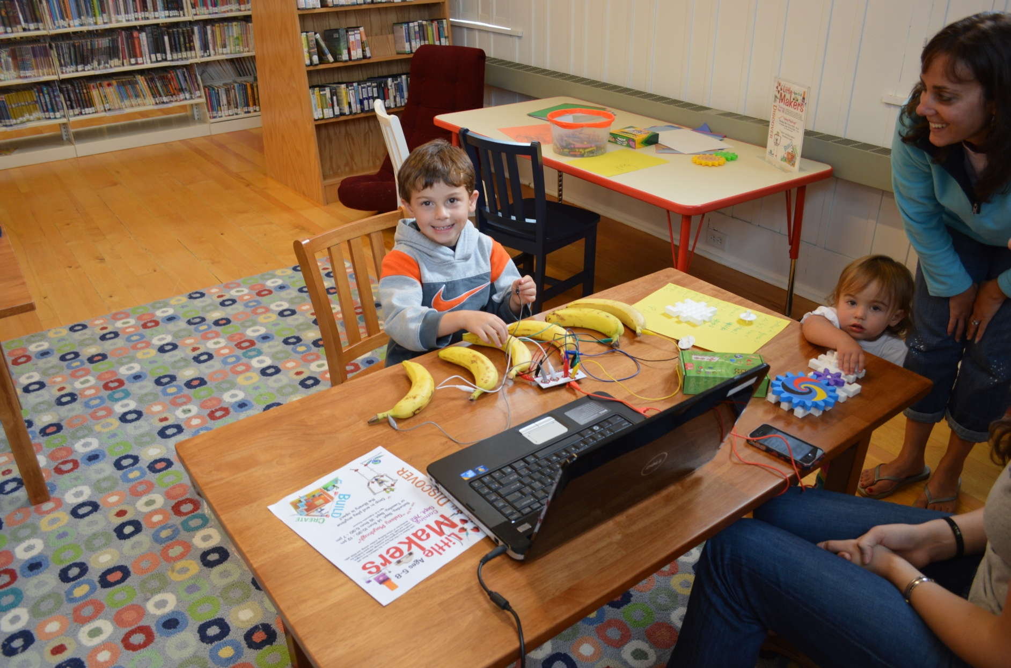
Notes:
SP
The space includes art supplies, and a range of toys that allow children to create. They can drop in and play with Goldie blox, roominate kits, legos, and more, learning a host of STEM skills while exploring science, technology, and art. This child is using Makey Makey, which wires external objects to your computer’s keyboard, to play the banana piano. He touches the banana and the computer responds by playing sounds, as if he were touching real keys

Slide 13
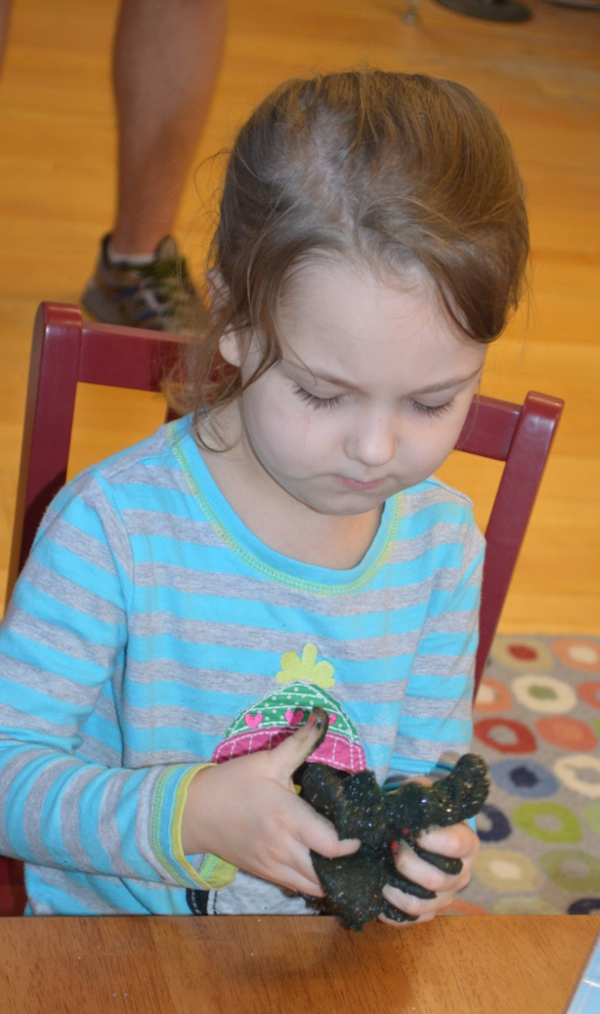
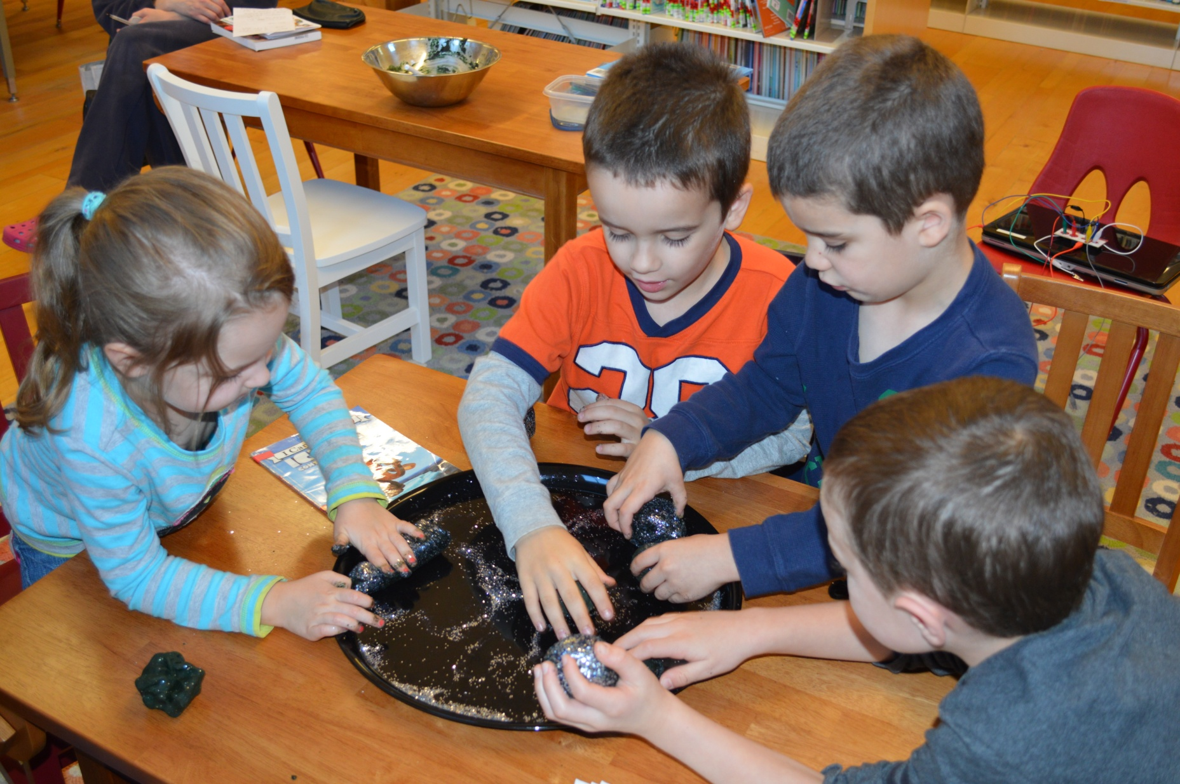
Notes:
Sp
Some examples of programming we’ve done in the space include making galaxy playdough. We made the playdough from natural ingredients, dyed it with food coloring, and rolled it in glitter to add the “stars.” Then we read a few fiction and non-fiction books and learned about the science of stars, in addition to using an educational computer program by NASA to explore outer-space.

Slide 14
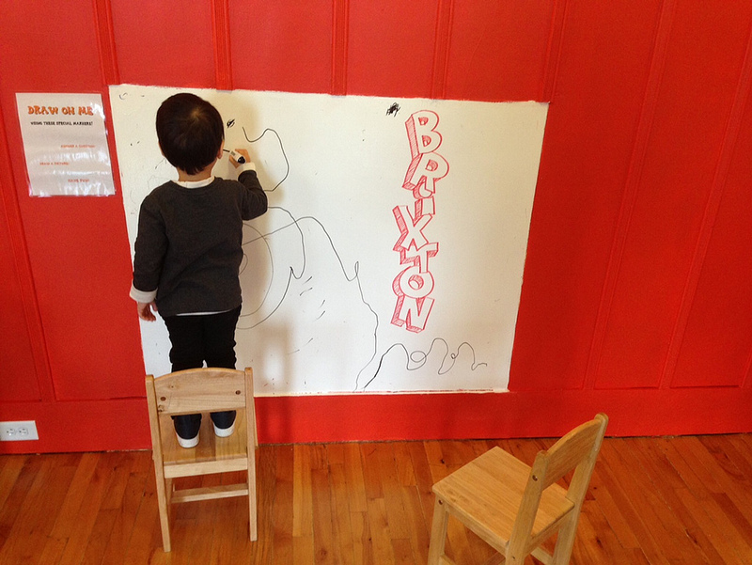
Discovery & Learning
Notes:
Ml
Like all of our spaces and makerspaces, these are places for free making and for specific services designed to support discovery and learning, and to build literacy and STEAM skills. The FFL Family Room helps build literacy skills through open play, and the Little Makers Area builds digital literacy and STEAM skills. By putting materials in these spaces we have created a place for hands on discovery and learning at all times. When the library is open these spaces are open and free to use.

Slide 15
Access
Notes:
Ml
All of our spaces support our mission of free and open access to ideas and information and are designed to increase community engagement by allowing the community to drive our library agenda. Through assessment and innovation at the FFL we will continue to provide open and free access to ideas and information and see what our community wants and as a team create spaces and programs that fit these evolving and always changing needs.

Slide 16
Next Project
Notes:
Sp
As we said in the beginning, we are constantly thinking about ways to make the most of our space. This next example is still in the early planning stages. There is hallway in our library that connects the main reading room with the children and teen’s rooms. It is sometimes used for local art shows, but tends not to be the center of the show. This space isn’t suitable for programming or for a drop in service, but that doesn’t mean there isn’t a way we can make it better.

Slide 17
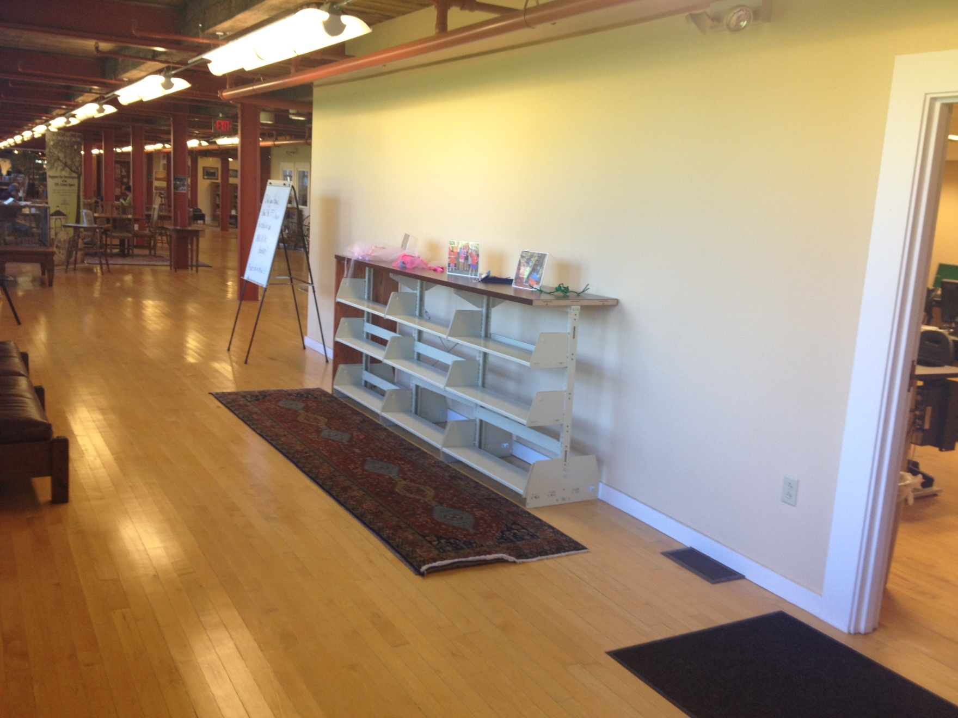
#FFLMakers
Notes:
Sp
#FFLMakers is a social media campaign that will allow library users to share the things they make and inspire others. We want to turn this hallway into an opportunity to display physical and digital examples of user generated content. Patrons will also be able to “check out” the display area with their library card, to curate any personal collections they might have. The display will change, monthly, and may center around a central theme.

Slide 18
Take a Tour
Of Your Library
Notes:
Sp
We encourage you to “take a tour of your library.” If you don’t already, make time to think critically about the ways your spaces are being used. Is there a corner or a hallway you think is underutilized? Is there a project or idea you want to execute, but just don’t think you have the space to accomplish it? Do an assessment and think again.

Slide 19
Dream Big!
Notes:
ML
After taking a tour of your library, dream big! Talk with other members on your team, brainstorm and come up with big ideas, no matter how unreachable they might seem! Turn these big ideas into a reality and reimagine your spaces! Innovate relentlessly as we do here at the FFL, take a chance it might flop but it also might impact your library, staff and patrons in a positive way just like the FFL Family Room and Little Makers area did here at the FFL.

Slide 20
Thank You!
Do you have any questions?
Fayetteville Free Library
Homepage: www.fflib.org
FAQs for Librarians: www.fflib.org/makerfaqs
Making! www.fflib.org/make
Twitter: @fayettevillelib
Facebook: facebook.com/fayfreelibrary
Susan Considine
Executive Director
Fayetteville Free Library
sconsidine@fflib.org
@sconsidine

