Slide 1

Common Core & Your Best Resource
Meredith Levine
Director of Family Engagement
Email: mlevine@fflib.org
Twitter: @schmoopie517
Margaret Portier
Director of Innovative
Family Services
Email: mportier@fflib.org
Twitter: @tophile
NYLA:SSL Expect More 2014 Conference
Notes:
Meredith: Hello and thank you for coming to this session and we hope you have been enjoying yourselves and learning lots thus far at SSL. Today we are going to be sharing with you some of the things we have been doing here at the FFL to support the Common Core and parents, teachers, school librarians and students and hopefully you leave today with great ideas to support common core in your school libraries or have ideas to share with your public librarian

Slide 2
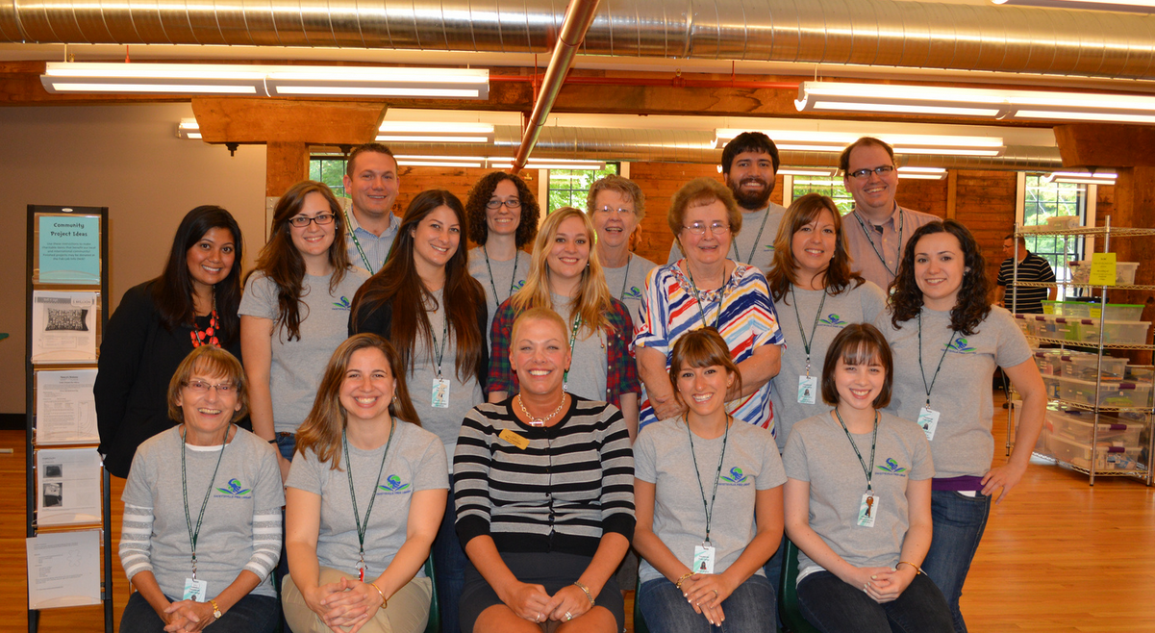
You are not alone.
Notes:
It is the PL mission to provide support and access
School curriculums change, we change too
It is our goal to support teachers, librarians, students and parents

Slide 3
Public Library Services
Your best resource for support and materials.
Notes:
We’re going to talk a little bit about the tools the Public Library has that we utilize to support the schools, teachers, parents, and children in our communities.

Slide 4
Collections
Nonfiction
Fiction
Nonfiction materials integrated into displays
Shifting to Dewey Hybrid in all collections around the library
  Integrating all media
Adding new material in the content areas to support STEM learning
Provide materials on school and grade reading lists
Displays support school projects and themes
Leveled Readers are clearly labeled
Picture books have Common Core Aligned labels
Notes:
Meredith: This year, in an effort to support common core through our Children's non fiction budget we reallocated existing funds. Nonfiction materials have been more integrated into displays and in our new books shelf location. This has increased circulation and interest in the collection. We look at the library collection as a whole; we currently shifted to Dewey Hybrid which will encourage discovery and make browsing the nonfiction collection much easier as books are shelved by category. We have completed this project and are working on categorizing the picture books. Media will be integrated onto the shelves as well, putting DVD”s about earthquakes for example next to books on earthquakes. New material in the content areas has been added to support STEM learning, carefully selecting items that are of interest in the field of science, technology, engineering and math. We have also increased the amount of nonfiction graphic novels.

Slide 5
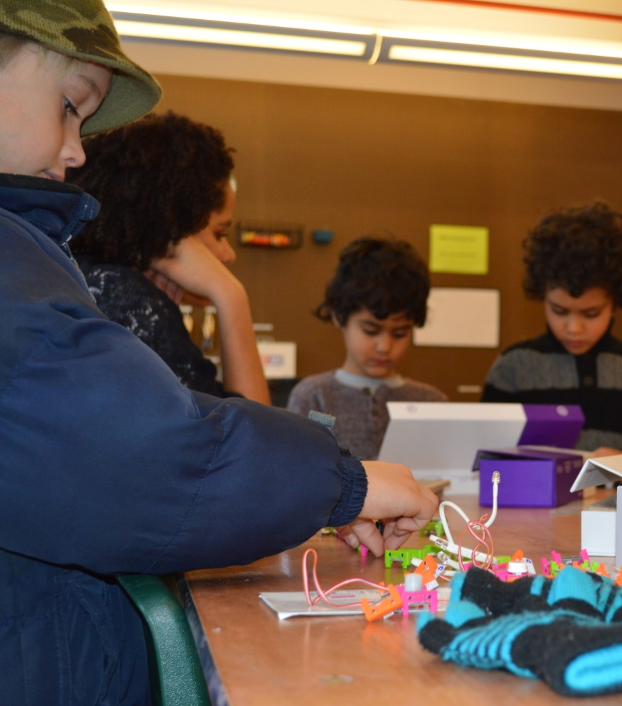
FFL Public Library Services to Patrons
Gold Star indicators on the children's collections denoting Common Core Aligned.
Our library website has a Common Core section with resources for parents and teachers.
ALSC website has great resources for public librarians about Common Core.
Notes:
As the Common Core becomes more prevalent and an everyday word used by parents it is our job here at the FFL to provide access to the best resources for our patrons. We plan to develop a pamphlet with resources for parents on different ways to support their children with the Common Core, including programs, websites etc. As we switch into Dewey Hybrid here at the FFL we want to create access to Common Core aligned material as easy as possible. We started placing gold star stickers on books in our collection denoting that it is Common Core aligned. These mostly include our picture book collection and we will use signs in the library for patrons to know that the gold star means the book aligns with the standards. To make it easier for patrons to access more information about the Common Core we have a Common Core section with resources for parents and teachers on our website, making the public library your one stop shop for information on the Common Core.

Slide 6





Databases
Anywhere
  Novelist
  Treehouse
  Mango Languages
Only in the Library
  Ancestry
  Lynda
Notes:
Margaret
In addition to our great traditional print collections, we also provide access to a number of amazing databases that can be used by teachers or students.
Accessible anywhere
– Could be used in the classroom.
Could be used for homework.
Accessible in the Library
Opportunity for a field trip to gain access to a really great resource and training on how it can be used

Slide 7
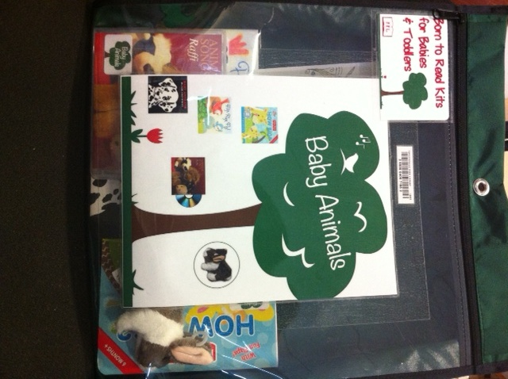
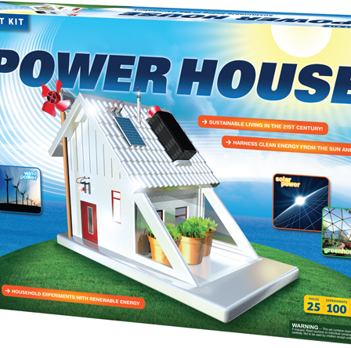
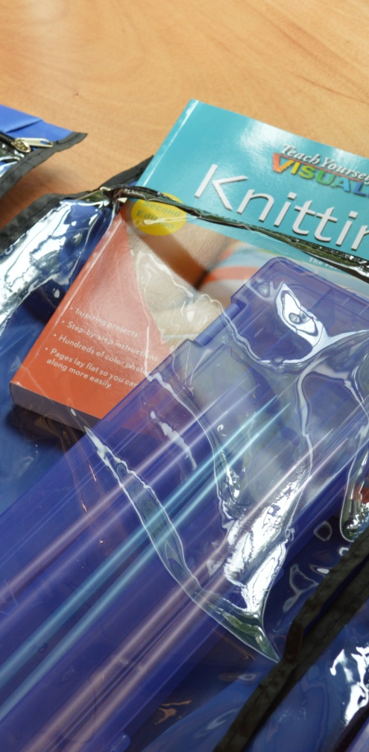
Kits
Skill Building
Early Literacy
  Born to Read
  Ready to Read
  Technology
STEM
Notes:
Margaret
Skill Building:
Knitting
Crochet
Weaving
Jewelery making
Cake pans
Kilowatt meters
Born to Read
3 board books, 1 toy, 1 CD, instructional pamphlet
Ready to Read
3 picture books, 1 pamphlet
Technology
ipad, pamphlet
STEM
Thames and Cosmos Renewable enegy Kits
Little bits
Snap circuits
K’nex
Makey Makey

Slide 8
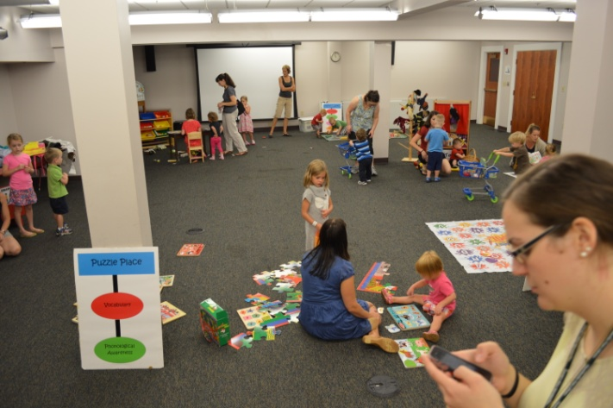
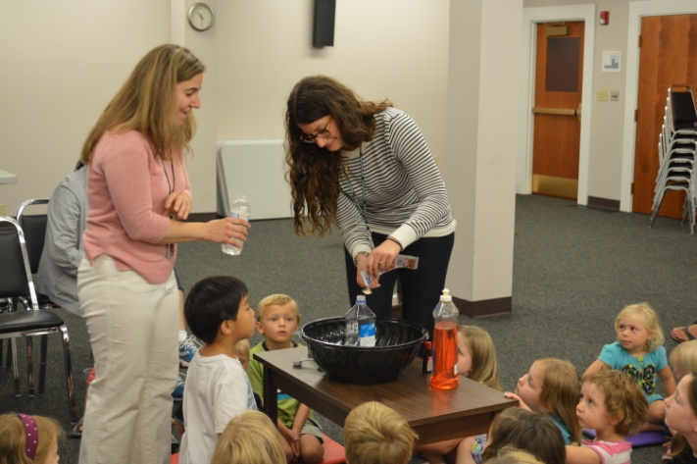
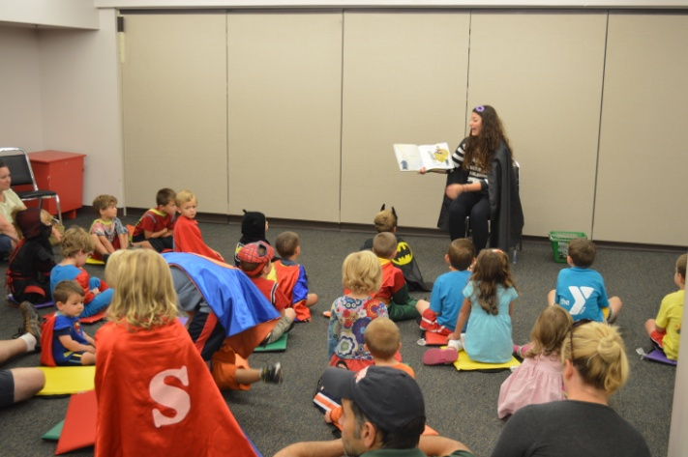
Early Literacy
Storytime
Smartplay
Summer Reading Program
1000 Books Before Kindergarten
Notes:
Meredith
-Storytime is an integral part of all public libraries giving all children and babies an introduction to books, rhymes, songs and more. We will discuss what the FFL does with storytime later on
-Smartplay is a drop in play program for preschoolers. There is a grocery store, a library, story board, letter mat, puzzles, crafts, puppet theater and play cars. Each station devlops one or more early literacy skills through the process of play with other children and caregivers
-Summer reading- At the FFL we have a separate Summer Reading Program for children 0-5. There is a reading and activity component. For ages 0-2 both the parents and child receive prizes for participating and some of the activities include babbling words, pointing at things along a drive and spelling out your name in the bathtub. For children ages 3-5 they receive an activity map as well with a bigger push on reading picture or board books. We find it extremely important for kids to learn to love and read books and the Summer Reading Program for early literacy is an exciting approach.
-1000 books before kindergarten is an organization that promotes a program in which young children starting from the year they are born have read 1000 books before kindergarten and if you think about it if you start when they are newborns and read one book a night you will have read over 1800 books before the child enters kindergarten. Similar to summer reading, after a child reaches a milestone like 100 books they receive a reward. We will be implementing this program this year!

Slide 9
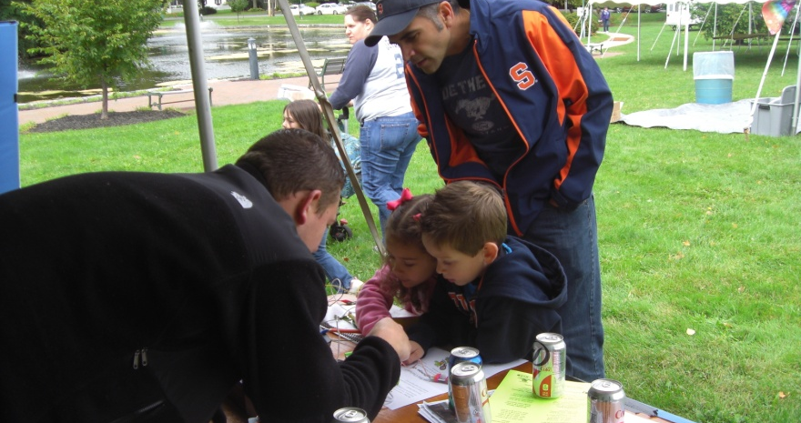
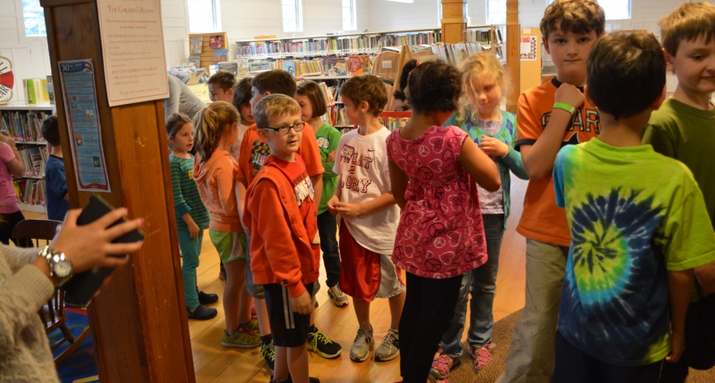
Outreach
YMCA Healthy Kids Fair
Fayetteville Festival
NY State Fair
School Visits
Field Trips
Teacher Happy Hour
Notes:
Margaret
All of these great collections, databases, and early literacy initiatives mean nothing if the public doesn’t know they are available.
So, we do outreach to raise awareness in the community of the amazing resources available in their public library. We attend local events and festivals like the YMCA Healthy Kids Fair, Fayetteville Festival, and this year we will be joining the rest of New York State libraries at the NY State Fair.
We visit local schools to talk about the library, do demonstrations and run programs, and enumerate the perks of having a public library card. We also invite teachers and their students to visit us for a field trip to get hands on experience with some of our kits, using our spaces, receiving training on our equipment, and for tours. Recently we have begun planning our school visits and field trips to talk about the summer reading program this year and all of the programs and opportunities that are available for children and teens.
It is our goal, while doing outreach, to not just share information but find potential partners and collaborators for future programs and initiatives. We especially want to create partnerships with schools and other educational organizations so that we can do our best to support education at all levels in our community.
Raise awareness
Share information
School library partnerships
Field trips
Mobile resources

Slide 10
Professional Development
Learning how to support schools.
Notes:
Meredith
This is how we are learning to provide support for you

Slide 11



Professional Development
Webinars
Workshops
  by publishers highlighting their new nonfiction offerings
  School Library Journal Common Core webinar series
  NYLA School Library section offerings
  OCM BOCES Common Core workshops
Notes:
As public librarians we try to attend as many webinars as possible, some of the information is repetitive but you can hear from the publishers about their new materials and how they align with the standards or hear from education experts about the Common Core. There is a plethora of information in these webinars. If you are a NYLA member it is always beneficial for us as public librarians to attend some of the Section of School Libraries section offerings especially around topics on the Common Core. Two years ago I attended the NYLA CE on Common Core in Saratoga Springs and that was one of the best presentations I experienced on the topic. .

Slide 12

Professional Development
Staff Training
Professional Journals and Organizations
engageNY.org – NY state funded Common Core informational site for schools and librarians
FFL Common Core Learning Day
School Library Journal
VOYA
Join Professional Organizations
Notes:
EngageNY is a great resource as we mentioned that can be used as a guide for the standards when staff has a question or is asked about the common core from a patron. FFL Common Core Learning Day is an event we hosted last year at our library for educators in the region. We had Barbara Stripling, Sue Kowalski and Jim Belair teach and discuss the standards with an audience mostly made up of public librarians. It is something we plan to do again in the future to make sure public librarians are up to speed on what is going on in the schools. We will continue to read SLJ and VOYA as this topic is touched upon frequently. Join professional organizations like NYLA and ALA and participate on committees and boards.

Slide 13
Programs
To further enrich the classroom education by providing access to tools and materials that empower students to learn on their own.
Notes:
Margaret

Slide 14
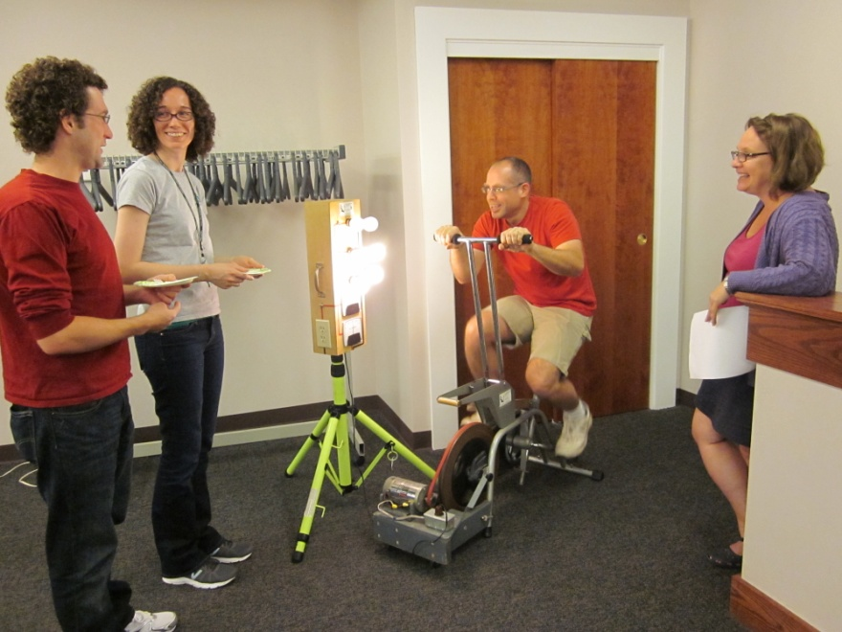
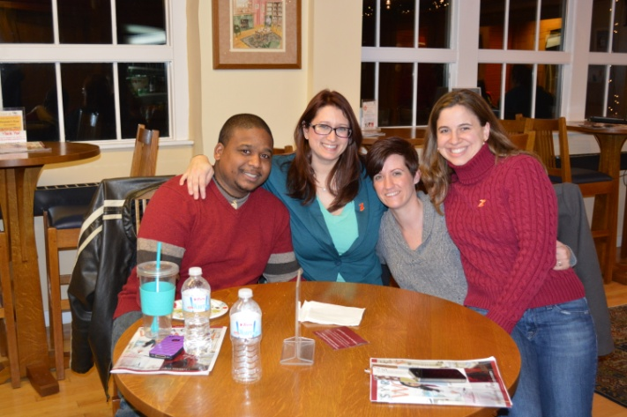
Teacher Happy Hour
Food and Drinks
Library Tour
Hands-on introduction to Kits
Notes:
Margaret

Slide 15
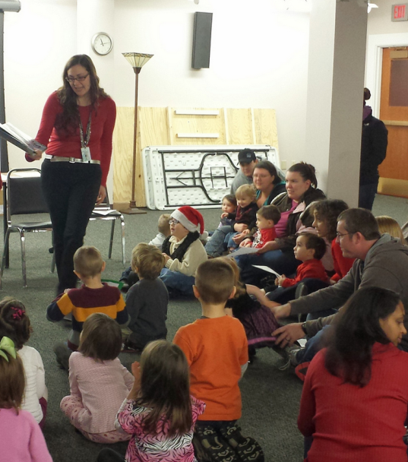
Storytime
6 Storytimes per week
  Ages 0-1
  Ages 1-2
  Ages 2-3
  Ages 4-5
  School Aged Children
  Musical Family Storytime
Early Literacy Skills
iPads
STEM
Music, Movement & Repetition
Creating life long library users
Notes:
Meredith: Storytime is the eye opener for young learners even before they walk, an effective storytime can make a significant impact that will get students ready for school. Storytime helps with physical development and health as well as social and emotional development. It increases children’s communication and literacy skills and introduces them to the world of math, science, technology etc. and creating a love of libraries and life long readers. The early literacy skills that we teach in storytime will create young learners who are more aware of their surroundings and ready for kindergarten. We use iPads in our storytime to incorporate different kinds of learning, touching, hearing and seeing actual images and sounds that relate to the stories we read. Music, movement and repetition create the developmental, emotional and social skills for children. We use at least one nonfiction title in our storytimes and ask lots of questions about the book to align with the ELA Shift 1. In storytime we have been adding hands on elements like using building blocks to make buildings, train tracks and trains to develop early engineering skills! In storytime we read books that might be a step higher then normal, creating a staircase of complexity. This intertwines with the academic vocabulary shift by introducing new words in each storytime and discussing what they mean. We have also been sending parents home with early literacy tips and activities to add another component to extend at home after school and after the library. (show example)

Slide 16
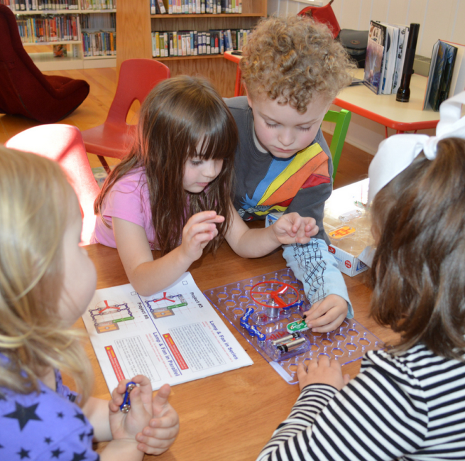
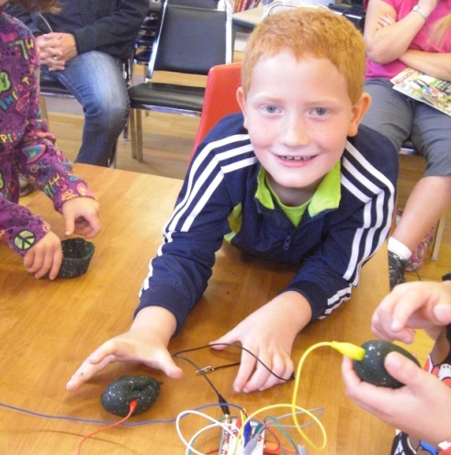
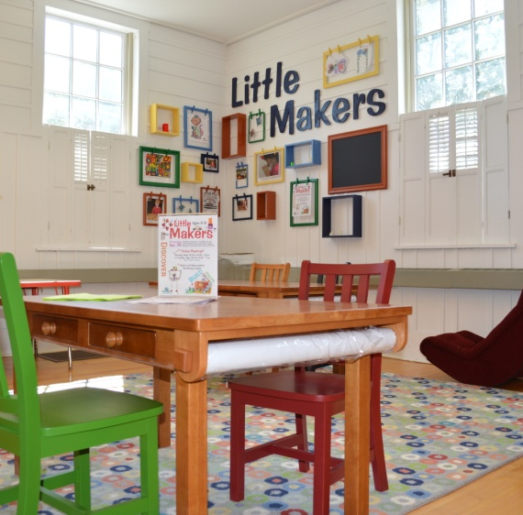
Little Makers
Little Makers Area
Little Makers Program
Notes:
Meredith: Little Makers is a free play area with complimentary programs that encourage children ages 5-8 to imagine, create, and build. The Little Makers area is open at all times when the library is open and has picture frames on the wall with clothespins for little makers to display their art work! It also has Roominate DIY wired dollhouse building kits, Snap Circuits which make learning how to use electronics easy (seen in picture), MaKey MaKey which allows you to become an inventor by alligator clipping the Internet to anything like bananas or Play Doh, Bionic Blox, an architectural construction and building set, Kaleido gears, which teaches children the simple principles of mechanics and Goldie Blox, which offer a story, games and activities to encourage girls to learn engineering skills. The Little Makers program happens twice a month where a story is read, a picture book and nonfiction component and then everyone does an activity, most recently Little Makers did a marble run, used hammers and nails to build their own wooden car and have used Snap Circuits, MaKey MaKey in previous sessions.

Slide 17
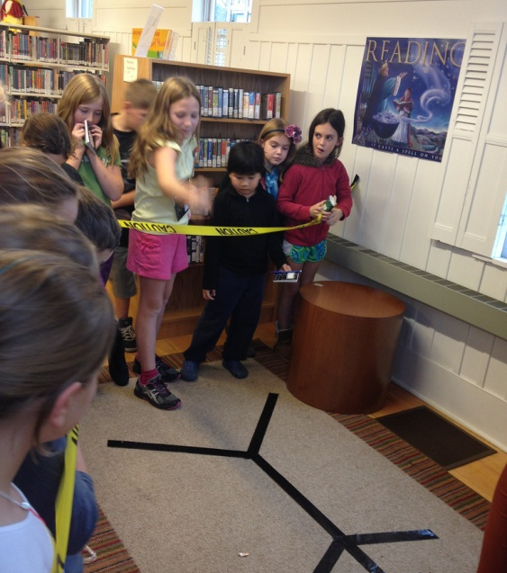
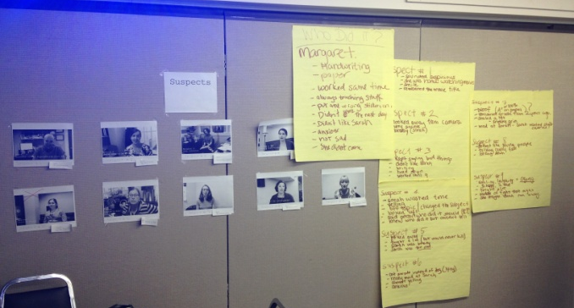
Murder Mystery in the Library
Yearly Program for school aged children
Evaluation of evidence
  Handwritten notes, video interrogations, actual crime scene clues
Comprehend information and critique
Notes:
Meredith: This program is for school aged children and tweens and we do it each year during a day off from school. I filmed 9 people on staff for interrogation videos and planted evidence around the library including a crime scene and handwriting samples. Each kid gets a spiral notepad and pen and has to take notes on all of the evidence and come to a conclusion via teamwork and discussion on who committed the crime. We took notes on big paper on each subject based on the various types of media that they analyzed, therefore writing from sources and creating text based answers. I made sure to use real terms such as evidence, interrogation, suspects to increase academic vocabulary and put the vocabulary into context. Patrons had to comprehend all the information given to them and critique what was presented. Margaret ended up being our number suspect and we made a successful arrest the first year we did the program!

Slide 18
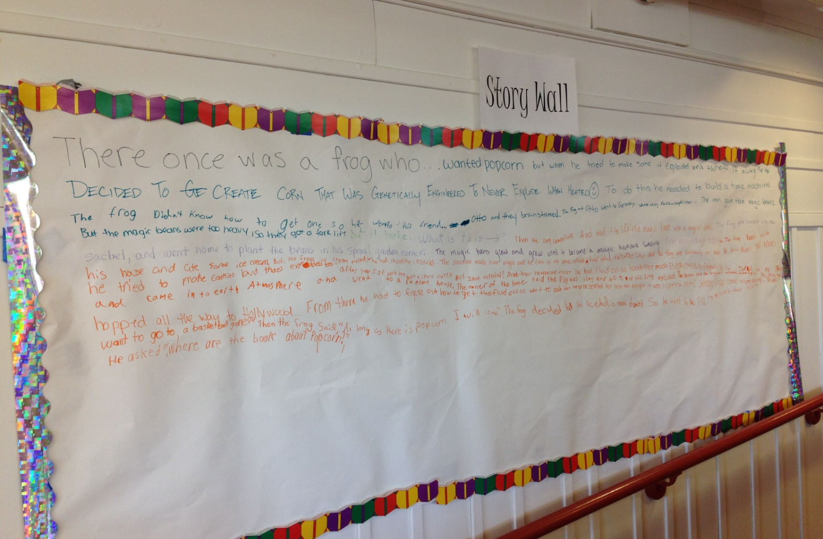
Story Wall
Narrative Writing
Creative Writing
Community Engagement
Notes:
Meredith: The Story Wall is a new installment at the library and it encourages patrons to write in the narrative, to encourage creative writing and a sense of community. Each month I will start the story off with a short opening sentence and let it go from there. Our first wall story started with a frog, who ate some popcorn that was genetically engineered and it exploded so the frog and his friend Otto went to Germany where they found magic beans….

Slide 19
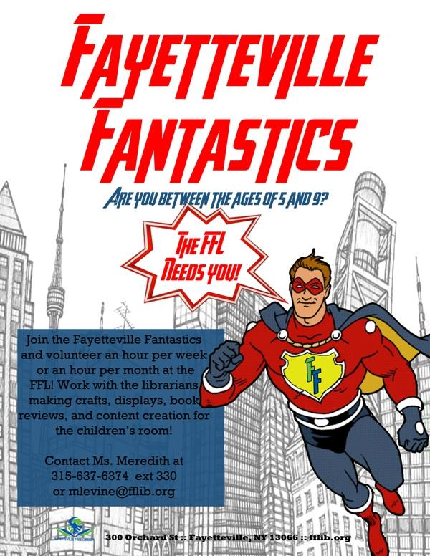
Fayetteville Fantastics
Volunteering
Maintenance
Responsibility
Creation
Ownership
Notes:
Meredith: The Fayetteville Fantastics is a new program that the library offers. Kids in elementary school can come to the library for up to one hour a week and help in the library! Every kid has a nametag on a lanyard that they wear during their shift (ownership) and have to spend at least fifteen minutes straightening up the library and in the remaining time they can organize books, create art to be displayed around the library, make book reviews, book lists and each month one fantastic will have his or her own book display with a bio about them and why these are there favorite books. This program is geared to create life long library users, creating a third space for kids after school (or during the day for homeschoolers) and to start kids young with basic job skills like having a schedule and being responsible.

Slide 20
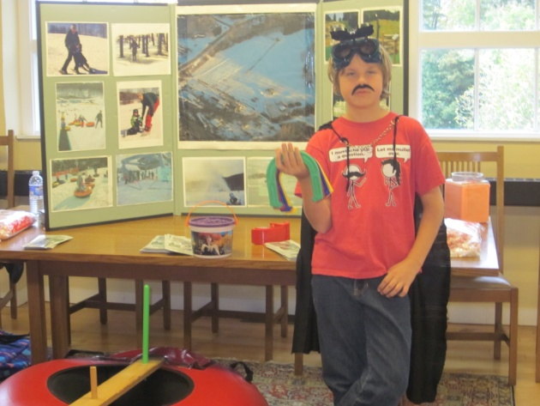
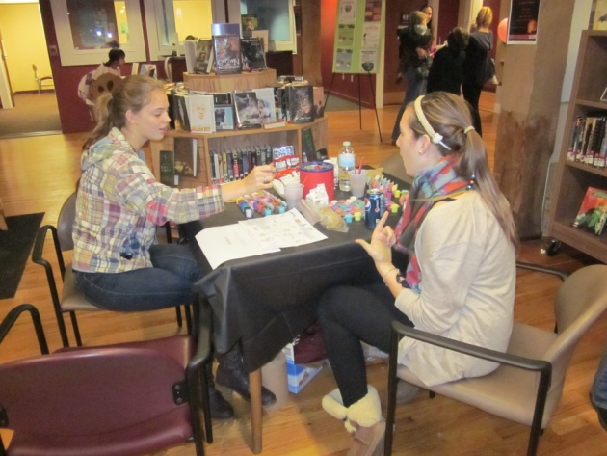
FFL Teen Corps of Volunteers
Adopt a Shelf
Teen Tech Squad
Bookworms
Program Support
Leadership Opportunities
Notes:
Margaret

Slide 21
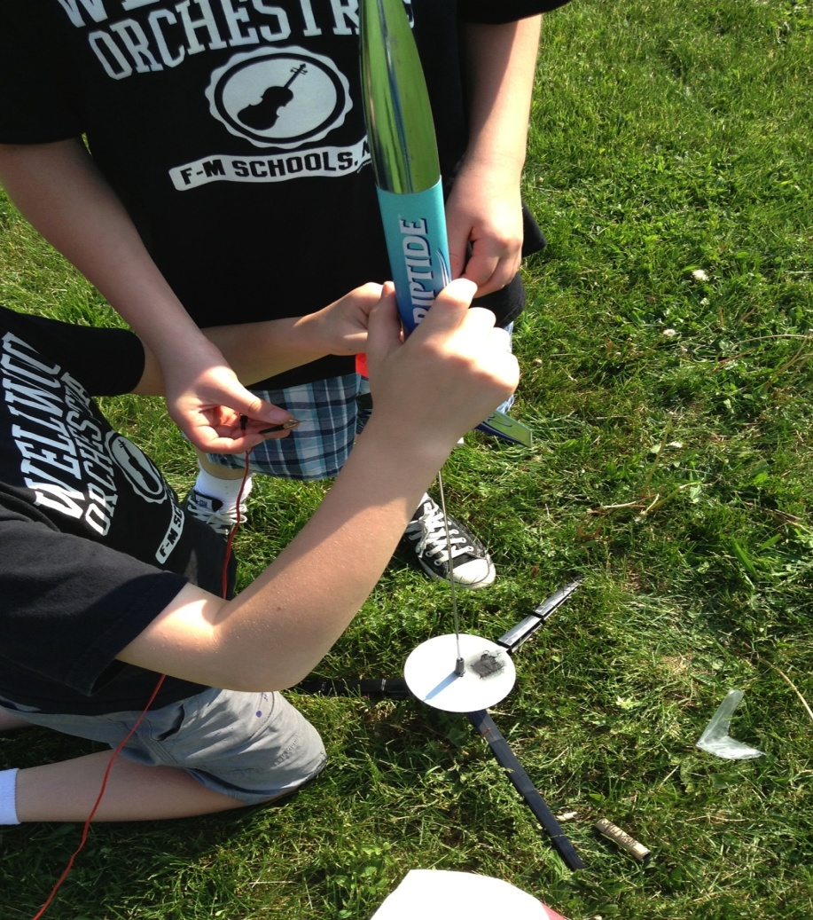
Secret Science Club
Each month sponsored by a Science Fiction novel
Book discussion
Hands on projects
  Hot air balloons
  Salt water and air batteries
  Wind turbines
  Takeapart
  Skeletons
  Rockets
Notes:
Margaret:

Slide 22
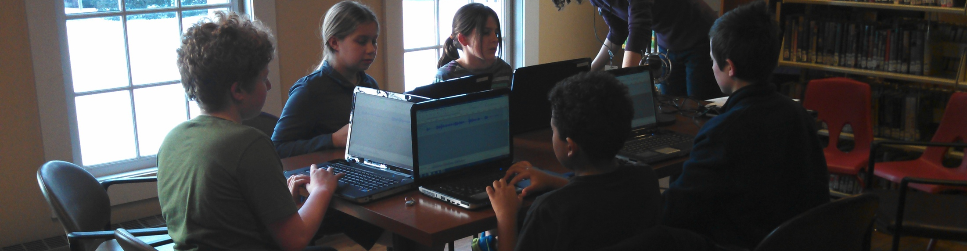
Creation Club and Creation Club Jr
Afterschool club
Each month there are two meetings
Learning to use digital media creation and editing tools
Using the FFL Fab Lab to bring ideas to life
Club Creations are shared on the library website and social media outlets
Notes:
Margaret:
Creaton Club: 6-8th grade
Meredith: With the great success from Creation Club, we started Creation Club Jr. for 3-5th graders. We have had over 12 kids per session and have trained kids on the 3D printer, 3D design, vinyl cutter, green screen and more.

Slide 23
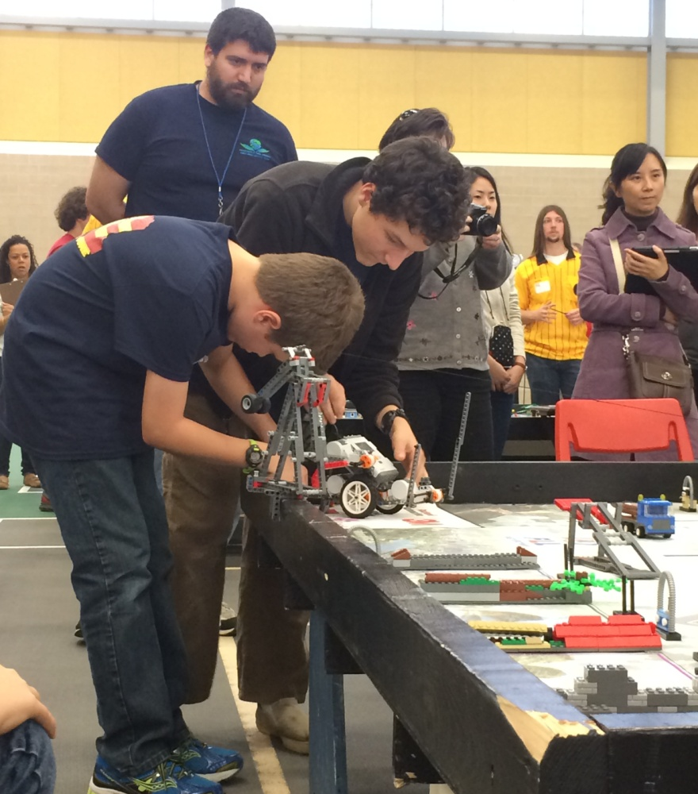
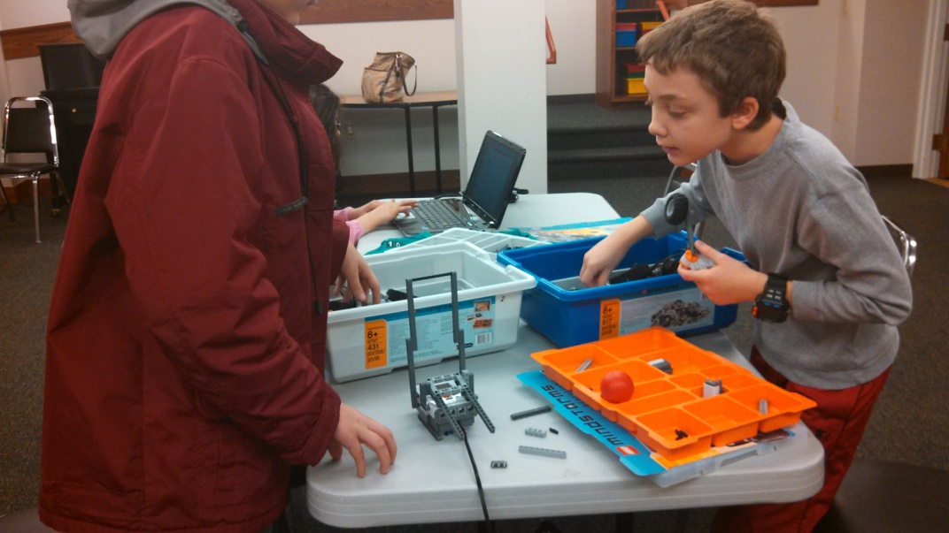
LEGO Robotics
First LEGO League
Mission:LEGO
Lego Brainstorm
Notes:
Margaret:

Slide 24
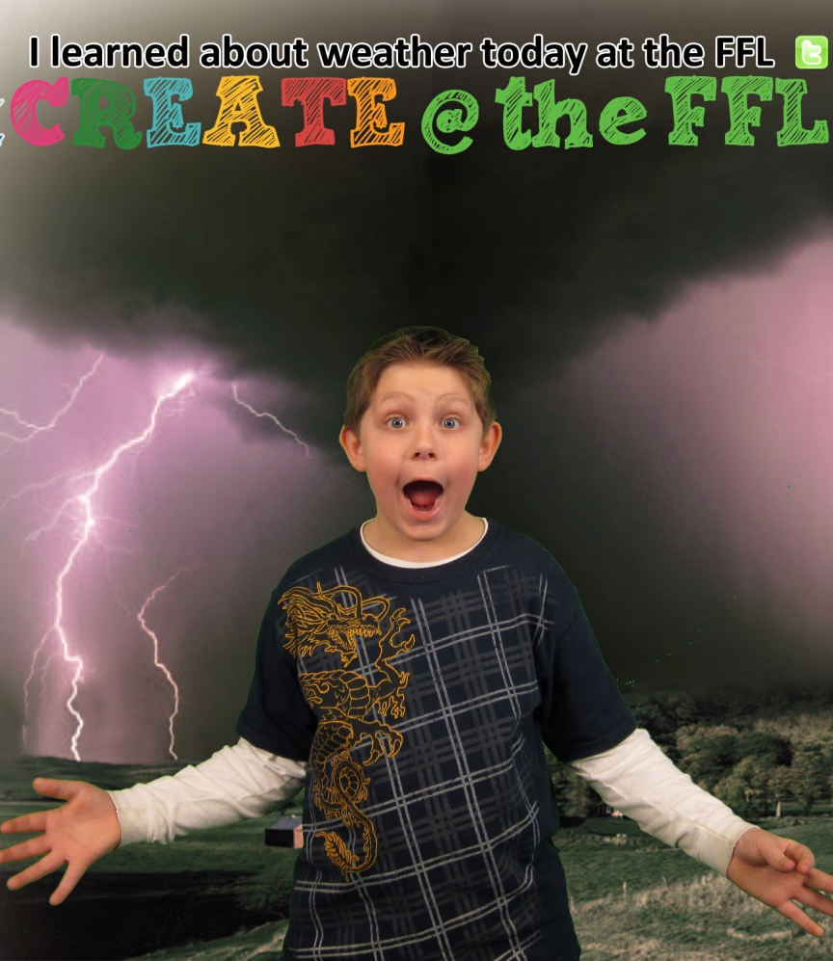
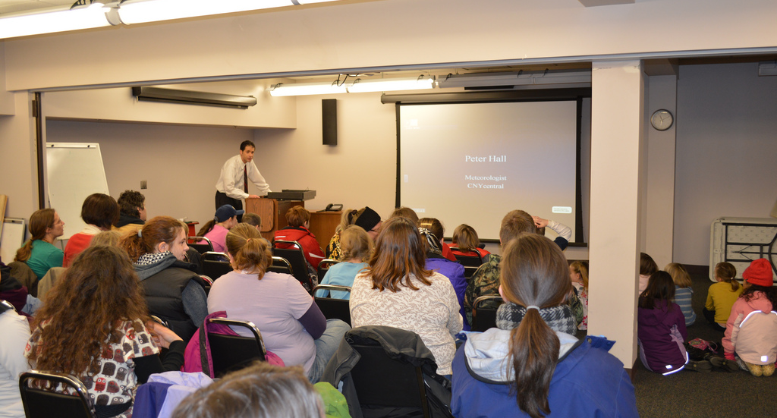
Extreme Weather
Local TV meteorologist talked about meteorology and television broadcasting
Used green screen wall to make kids into Weathercasters
Notes:
Meredith
We had local meteorologist Peter Hall at the library before a group of 75 plus patrons. Hall discussed his job both tracking the weather and broadcasting on television. He discussed in great lengths about the weather and the science behind it, therefore aligning to the knowledge in the disciplines. He used a plethora of vocabulary used in the field. We felt that this also created a college and career readiness skill. Hall described how he does the weather in front of a green screen so we decided to use ours and Photoshop those pictures in front of something weather related, so children were using technology and digital media strategically to capture the essence of being a real weathercaster. We combined science and interest in career into one program. This summer we plan to do another similar program.

Slide 25
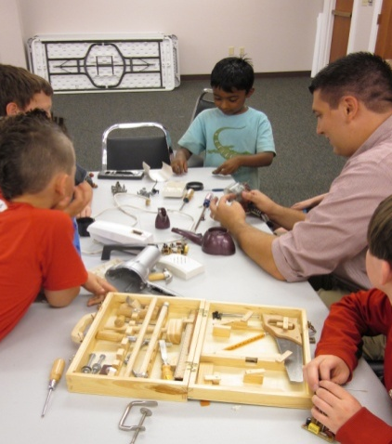
Takeapart Tuesday
Community donated broken and used technology
Bring Your Own Tool event
Patrons work together to take apart the machines and figure out how they worked
Notes:
Margaret:

Slide 26
More Programs
Now
Summer
Make Your Own Book
MinecraftEdu
NOVA Making Stuff
3D Printer and Laser Cutter Certification
Young Scientists
MOST Museum (OCPL)
Zoo to You (OCPL)
Summer Reading Program
Geek Girl
Notes:
Meredith: Make Your Own Book is one example of our maker programs that we offer for school aged children and teens. This gives an opportunity for patrons to write from sources around the library and create a final product to take home. We have Minecraft Edu on all of our computers in the teen space and on our laptops. We have had huge success with our special Minecraft programs like Minecraft Hunger Games and more.
We received two large boxes of “stuff” from NOVA and just last week we ran two Nova programs. We made things colder y making hand-powered fans out of paper and tried different materials and designs to maximize the fan’s effectiveness. We also tested the strength of the wild by creating a single “eagle toe” our of various materials and tested its motion control and strength.
We offer all patrons access to our 3D printers and Laser Cutter and require each patron to take a 45 minute certification course with a librarian and then they have access to the machines whenever the Fab Lab is open. Tomorrow Pete and Mike from the FFL will be talking about our Makerspaces and we suggest you attend.
Over the summer we have the Young Scientists program which is run by a local science teacher who comes up with a series of experiments that go along with the summer reading theme. The MOST museum in Syracuse and Rosamond Gifford Zoo come to each library in the county and these programs are always popular.
This year’s Summer Reading Program has the Fizz Boom Read theme so we have planned some very exciting and fun programs around that theme and plan to have great nonfiction book displays to support
Finally this summer we will be implementing Geek Girl Camp. A week long camp from upper elementary students who will be coming to the library everyday to learn STEAM skills and also hear from inspiring, awesome women in STEM careers such as ocean engineers, scientists and tech savvy women who work at giant companies like Facebook.

Slide 27
We ask of you….
Recognize your students for their extracurricular activities, for attending public library programs and clubs, consider the public library your partner and not your competitor, cross-promote programs and education initiatives, and the list goes on….
Notes:
Margaret

Slide 28

Questions?
Sue Considine
FFL Executive Director
sconsidine@fflib.org
Fayetteville Free Library
Website: www.fflib.org
Twitter: @fayettevillelib

